Slide 1
The Nightingale Hospital London Learning System
Richard Bohmer, Jenny Shand, Dominique Allwood, James Mountford, Andrew Wragg
May 2020 v1.0

Slide 2
Contents
Principles and purpose of the Nightingale Learning system
Dashboards & Data Visualisation*
External evidence
Staff Experience
Bedside Learning Coordinator**
Component of the learning system*
Audit*
Quality and Learning tracker
Learning system dashboard
Decision making*
Key:
Learning System
Staff Experience
BLC
Decision making
Please also refer to *NHL Clinical Governance Pathways
^{document and **BLC handbook}

Slide 3
Learning System
Principles and purpose of the Learning system
Nightingale is a learning system
The unique context requires a rapid learning cycle:
Rapidly evolving understanding of a novel disease
High stress environment for staff
Physical constraints of “hot” zone
Demands of rapid scale up
For patients, staff and wider NHS benefit, we are therefore committed to learning fast and acting fast across all dimensions: clinical, operational, and staff wellbeing.
The learning system is based on the following five principles:
identify known areas of uncertainty
help the caregiver to help the patient
reduce the burden on front-line clinical staff
learn from every patient
associate all important practice changes with a rapid feedback loop.

Slide 4
Learning System
Nightingale Learning System overview
External Advisory Group
Q&L Team
Internal Data
Internal Change Authority
Testing, sim & research
Implementation into Action
Share inter / nationally

Slide 5
Learning System
Nightingale Learning System: Unique elements
What it is
Full time role dedicated to capturing data and insights from the bedside and relaying changes back to staff on a 24 hour cycle
Who it is
Diverse group of staff drawn from nursing, medicine, pharmacy, therapies and non-clinical staff
What it is
Running list of interventions derived from internal data
Who is responsible for it
Q and L team
How it is used
Updated daily and used to triage actions to operations and clinical teams
What it is
Weekly review of the literature and conference call outputs
Who is responsible for it
Collaboration with UCLP
How it is used
Integrated with internal data to create Q and L outputs
Presented to the Clinical Forum weekly
Bedside Learning Coordinator
Q and L Tracker
External experience and expertise

Slide 6
Learning System
Daily data driven change and review cycle
Barts and NHL Governance
Executive Strategic, External and academic inputs
Daily data collection
NHL Quality and Risk Board (wkly)
Datix incidents
Dashboard
CHANGES
Fix / Improve / Change Items
Clinical Forum
4pm
Staff survey
Q&L Lead updates Q&L Tracker and classifies each item
Staff roster data
BLC observations
Scanned form to BH Business Intelligence
Task and Finish groups as required
Testing/validation as required
Triaged to appropriate decision group
ImproveWell staff feedback
Thematic analysis by ImproveWell
Operations
(meeting 8.30am / 10am; 1:1s)
Staff shift debrief
Feedback forms in box at S10 collected by Q&L
Matrons
(1.30pm /1:1 with admin matron)
Operations changes
Workforce
(9.15am / 1:1s)
Update change tracking log (Q&L)
Workforce
changes
Clinical Reference Group & Clinical Oversight Group (2-4 / week)
Clinical changes
Clinical forum

Slide 7
Learning System
Systematic way to communicate changes back to
the floor
Training & Education:
Induction / Day 0 SIM / on the floor updates & teaching
Before shift
Nightingale staff newsletter / Nightingale People website
Model to be fully tested for reopening
*Not implemented before standby
Email / ImproveWell alert to relevant staff
Clinical Standards and Protocols:
Governance sign-off
Update Quick Reference Guides and SOPs
At entry into clinical area
Electronic boards and whiteboards inside Excel
Change
agreed
(ops/ matrons/ CRG/ 4pm clinical forum)
Tactical Ops reminds staff of the day’s changes at shift check-in
Operational and support services:
Clinical Informatics
Equipment, Procurement
Others
Audit
Placed on white boards at staff check-in
Perfect Ward Audit tool*
Communications:
Daily key message log (including safety messages)
Q&L weekly summary of significant changes
“”We said-We did” messages
Within the clinical area
Consultant, Matron, bedside checklists and teaching
BLC, Tactical Ops and others audits
Update change tracking log (Q&L)
Intranet (WeShare and QRG)
BLC and other reminders at the bedside

Slide 8
Learning System
Audit plays a wider role in the Nightingale system
The role of audit
To provide assurance
To understand if a change has been successfully implemented
To generate clinical insights
To adhere to regulatory responsibilities
Analysis
Time trends / control charts
Local, national and international benchmarking
Data collection
Mandatory
Discretionary
Desk based
Report and publish
Shared at 4pm
Headlines in weekly staff newsletter
On the floor
Audit recommended by:
Matrons
CRG
Specific service or team
Clinical Forum
Q&L team (to close loop)
Audit registered in Trust CEU database
BLC
Specialty team
Implications acted on
Close loops on actions
Review implications for clinical and operational model
Combination of both

Slide 9
Learning System
Data sources
Insights triangulated across data sources to inform change
2. Hospital dashboard
3. Reported Incidents
1. Bedside Learning Coordinator insights
4. Admission volumes and changes to criteria
5. Staff suggestions and experience
6. National and local clinical audit
7. Mortality Reviews
8. Complaints
9. External Evidence Synthesis

Slide 10
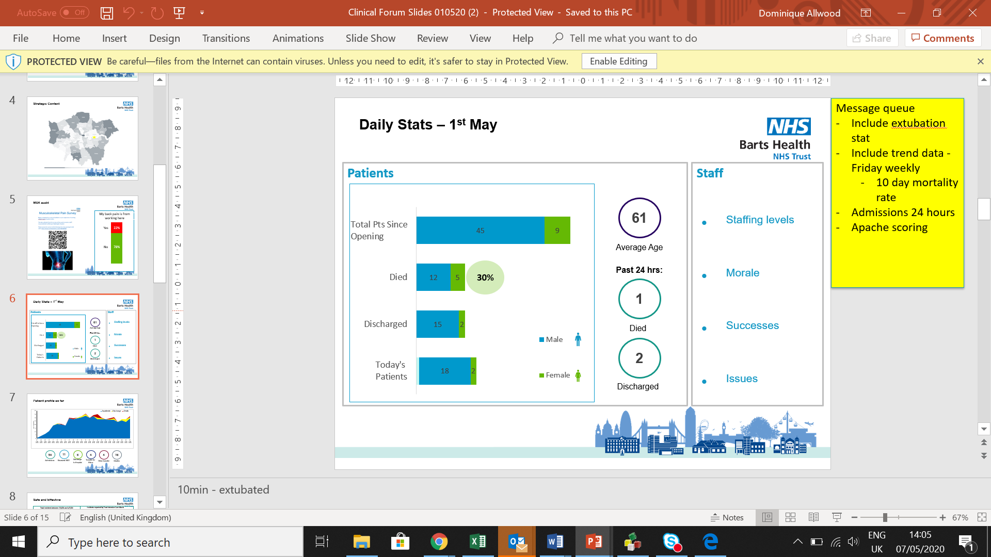
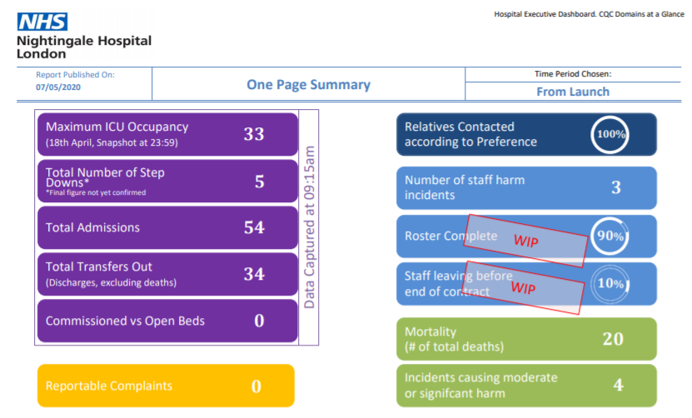
Learning System
Dashboards &
data
Data presented daily at 4pm forum including admissions & outcomes and case mix presented by the ‘voice from the floor’

Slide 11
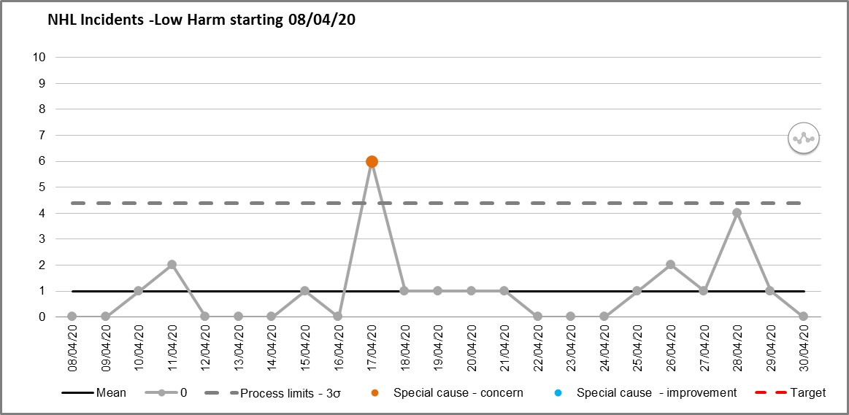
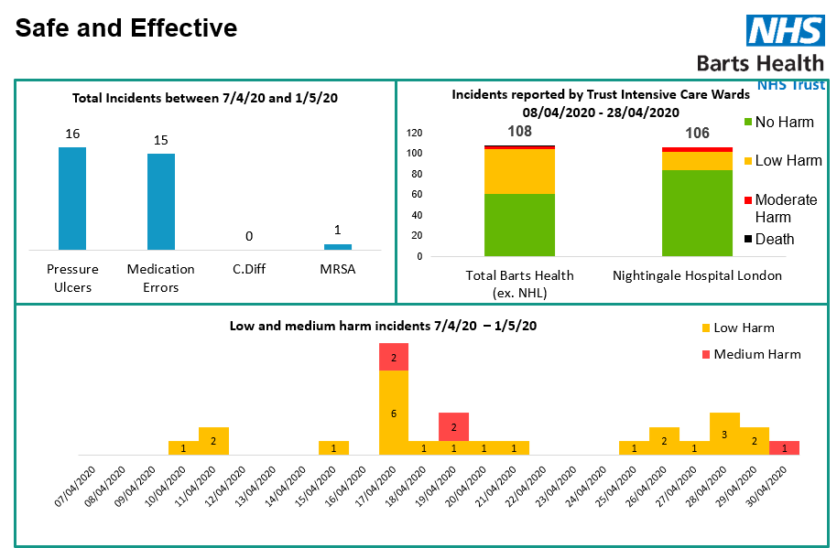
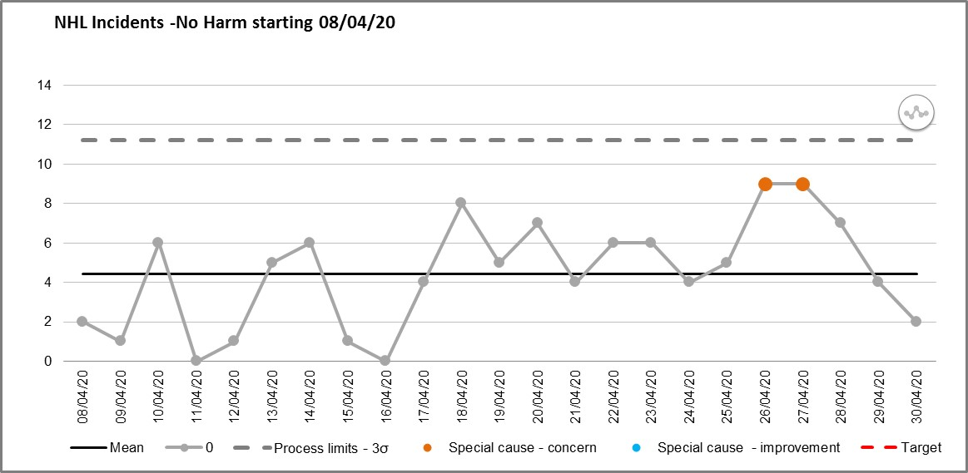
Learning System
Data visualisation
Where possible, data is visualised using run charts, time series, SPC and benchmarking to understand opportunities for change and impact of improvements

Slide 12
Staff Experience
ImproveWell app gathers both staff survey data and suggestions for improvement
This shift was better than the last one (yes/no)
On my last shift, I felt unsafe (Likert scale - 1=never, 2=seldom, 3= often, 4= always)
On my last shift, I felt unsupported (Likert scale - 1=never, 2=seldom, 3= often, 4= always)
On my last shift, I felt physically exhausted (Likert scale - 1=never, 2=seldom, 3= often, 4= always)
On my last shift, I felt mentally exhausted (Likert scale - 1=never, 2=seldom, 3= often, 4= always)
How can we make tomorrow better? (Free text)

Slide 13

Staff Experience
Staff Survey data 7/4 – 30/4
On my last shift, I felt….
The last shift was better than the one before:
5
Always
No
26%
Yes
74%
Never
1
Safe
Supported
Physically able
Mentally able
n=27

Slide 14
Staff Experience
ImproveWell summary

Slide 15
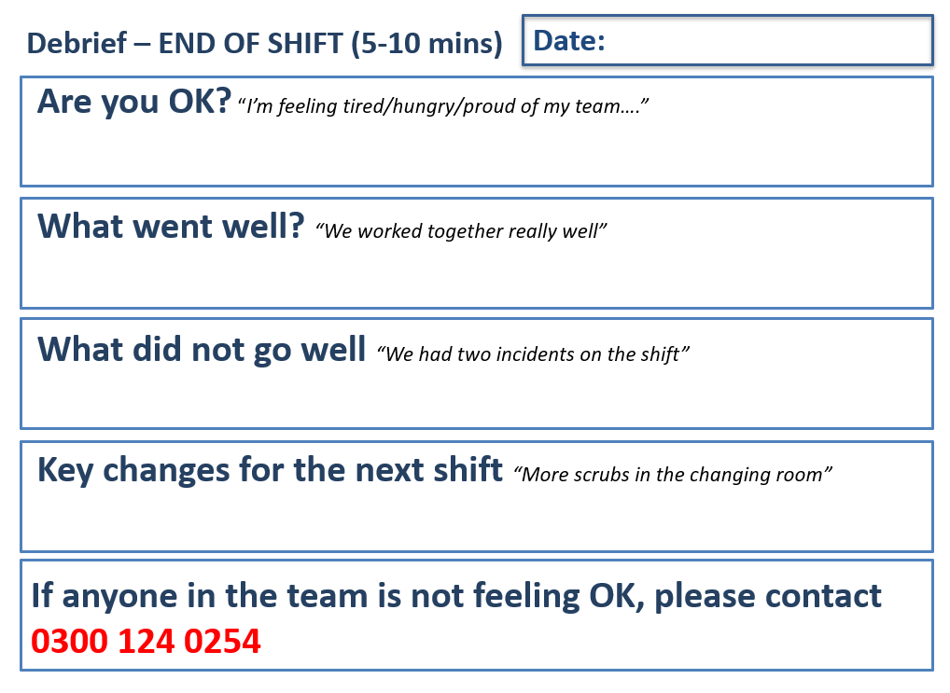
Staff Experience
Staff Debrief Proforma

Slide 16
BLC
Bedside Learning Coordinator Role
The Bedside Learning Coordinator role is designed to address several challenges that are in place by the nature of the hospital and Covid-19
Staff turnover – daily changes
Boundary of contamination/hot zone
Required speed of learning and cycle time of changes required
Staff coming from multiple trusts with different ways of working
Intensity of the clinical area necessitates removal of tasks where possible – e.g., Datix reporting

Slide 17
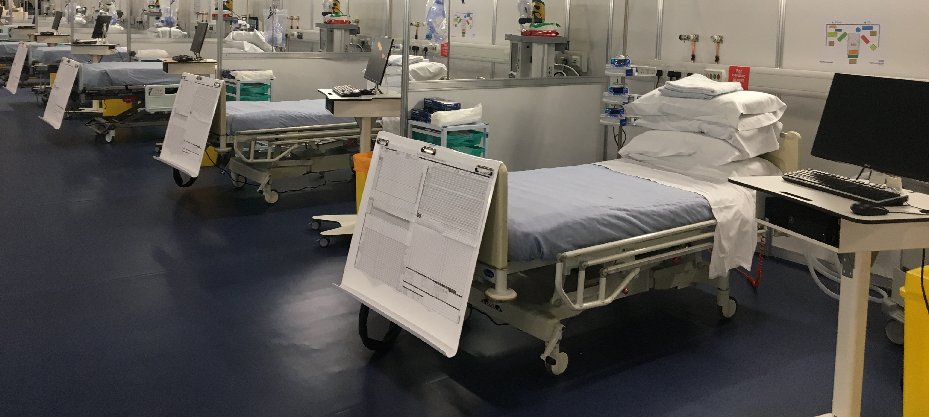
BLC
Summary of the Bedside Learning Coordinator
Problem: Insights from the clinical area are not easily captured by existing data flows
BLC role: Gather data and ideas from the bedside
Problem: Staff feel overloaded keeping on top of rapidly changing information
BLC role: Return changes to the bedside
Gather data and ideas
from the bedside
Return changes to the bedside

Slide 18
BLC
The Bedside Learning Coordinator
The Learning system aims to: 1. Learn fast 2. Act fast across all domains – clinical, workforce and operational. The Bedside Learning Coordinator is a new role critical to the function of the learning system at the NHS Nightingale Hospital London.
The BLC’s job is to…
Gather data and ideas from the bedside
Return changes to the bedside
    interview people working on the floor to gather ideas and suggestions about clinical, operational, training and workforce issues,
    feed these insights back to the Quality and Learning team and participate in evaluation, redesign and action distribution
    input data on harm, incidents, and safeguarding concerns on Datix as required in coordination with the shift leadership team
    alert people working on the floor to clinical and operational changes that have happened since yesterday
    share top tips and positive learning
    collaborate with the Matron and shift leadership team to follow up on actions and learning cycle

Slide 19
BLC
The Bedside Learning Coordinator
BLCs will have diverse experience and backgrounds, both clinical and non-clinical, giving wide perspectives on the floor. As such…
All BLCs WILL…
BLCs CANNOT be relied upon to. . .
    Support members of staff on the shift
    Gather critical learning for making Nightingale better tomorrow
    Provide an extra pair of eyes and ears for the Matron and shift leadership team on both positive insights and areas for action
    Implement on the spot fixes as appropriate and in collaboration with the Matrons and shift leadership team
    Provide direct clinical care
    Directly lead the response to clinical critical incidents
    Replace the role of the Matron or other shift leaders
    Fill rota gaps in the event of staff absence

Slide 20
BLC
Our BLCs are multi-disciplinary leading to diverse insights
Pharmacists
Critical Care nurses
Nurse Educators
Dieticians
Speech and Language Therapists
Research leads
OTs
Speech and Language Therapists
Doctors
AHPs

Slide 21
Learning System
External evidence review
Weekly evidence summary containing rapid synthesis and dissemination of evidence, emerging clinical findings and front line experiences

Slide 22
Learning System
Quality and Learning tracker
 | DATA CAPTURE FROM BLC FORM, IMPROVEWELL & STAFF DE-BRIEF |  |  |  |  |  | MANUAL DAILY UPDATE
ID | Date Captured | Observation | Source | Area | Type of Change - Fix / Improve / Change | Observation type | Sub-category | Action Required | Urgency | Report
Source insights are categorised into Fix-Improve-Change and actions assigned
Actions are taken to the relevant forum or individual
Follow up audit and review ensures actions are successfully implemented and closed
Where actions have not addressed source concern further actions are tested and implemented
ASSIGNED FOR ACTION
Date Raised at Forum | Forum | Person assigned action | Due Date
RESOLUTION |  |  |  | BLC AUDIT / FEEDBACK LOOP
Closed | Status | Outcome / Info | Flag for potential audit | Date | BLC audit | Feedback

Slide 23
Learning System
Fix Improve Change
Insights from multiple sources are categorised into three domains of problems to be addressed
Focus of clinical forum discussions
Fix
Improve
Change
Actions to be implemented immediately, either on the spot of via operational leads (to make sure we are doing what we said we would)
Many are associated with snagging items and gaps in equipment as teams start using the clinical area
Finding new ways to do things that are better than we currently do
These could include adjustments to task allocation across staff, changes to the flow of patients through the unit
Substantive changes to the care we deliver
Likely to be predominately related to clinical protocols
These could be due to innovations, new understanding of how to treat and manage covid, or critical shortage of supplies

Slide 24
Learning System
Fix Improve Change
Insights are categorised into fix-improve-change and audited to ensure actions are successfully implemented
Fix
Improve
Change
Actions to be implemented immediately
Finding new ways to do things that are better than we currently do
Substantive changes to the care we deliver
e.g. How to identify staff in PPE
e.g. Day 0 simulation training
e.g. new VTE protocol

Slide 25
Learning System
Regular review of activity ensures change is delivered at pace
Overtime, we would expect the focus to shift onto improve and change if the unit were running at larger scale
^{% Closed}
184
111
10
^{Total items raised}

Slide 26
Learning System
Learning System Dashboard 7th April to 5th May
Type of Change | Status |  |  |  | No change | Total | % complete
 | Complete | In Progress | Monitor | Pending
Fix | 97 | 20 | 24 | 18 | 25 | 184 | 66%
Improve | 51 | 10 | 24 | 12 | 14 | 111 | 59%
Change | 4 | 1 | 4 | 1 | 0 | 10 | 40%
Total | 152 | 31 | 52 | 31 | 39 | 305 | 63%
Type of Change | Observation Type |  |  |  |  |  | Total
 | Equipment | Process | Protocol | Staff | Wellbeing | Other
Fix | 76 | 36 | 17 | 39 | 14 | 2 | 184
Improve | 12 | 23 | 26 | 41 | 9 | 0 | 111
Change | 1 | 0 | 6 | 2 | 1 | 0 | 10
Total | 89 | 59 | 49 | 82 | 24 | 2 | 305

Slide 27
Learning System
Solutions to problems identified can be simple or complex
SIMPLE
A solution is simple if:
the need and solution is certain and widely agreed
can be actioned by one workstream
doesn’t require research based critical evaluation
has few interdependences
COMPLEX
A solution is complex if it requires:
cross-workstream collaboration or multiple workstreams to change (including external groups)
significant change(s) to or new resource allocation
significant change(s) to work flow
critical evaluation or significant validation and testing (e.g., meaningful departures from current medical practice)

Slide 28
Learning System
Types of problems and types of solutions
Fix
Improve
Change
Changing how we prone patients and new management of patients when in prone position
Stock labelling and trolley management
Ensuring accuracy of allergy information from referring sites
Drug substitution due to supply shortage
Day one simulation for all staff
Changing the extubating prediction model and protocol (and therefore the flow of patients through the floor)
Implement VTE protocol
Dismantle staircase
SIMPLE
COMPLEX

Slide 29
Learning System
Summary of the Nightingale Learning System
Coordinate
Integrate
Changes in ..
External Advisory Group
Clinical care
Operations
Workforce
Q&L Team
Accept – Fix, Improve, Change
Study
No change
Cycle times
Immediate changes
ST validation / sim
Quantitative research
Internal Data
Internal Decision Authority
Implementation
Testing, sim & research
Protocol / SOP change
Education / training
Implementation into Action
Share inter / nationally

Slide 30

Decision making
Decision authorities
Three levels of decision making authority for clinical teams. These form the intersection of learning and governance
4 pm Clinical Forum
Clinical Reference Group
Operations
daily
meeting
Fix
Clinical model and staffing
Matrons daily meeting
Compassionate Care weekly update
Improve
Change
Clinical Oversight Group
Medicines Safety and Governance
Mortality and Morbidity
ICU Clinical Governance Group
Mortuary and Death cert.
FSLT and bereavement
Quality and Learning SLT
Stepdown working group
Medical Equipment Procurement Advisory
Training and education liaison
Safeguarding

Slide 31
Decision making
Decision authorities
There are three levels of decision making authority for clinical teams
Clinical Forum
Oversight & Scrutiny
Overview of decisions at forums and expert groups and ability to scrutinise and challenge
Identify and address interdependencies
Identifies new issues requiring action
Strategic and multi-disciplinary leadership committees
Endorse relevant expert group decisions
hold significant delegated authority
Informs clinical forum of decisions made
Evaluate relevant internal and external data and insights
Prioritise activities
Clinical Reference Group
Operations
daily
meeting
Decision Forums
Clinical model and staffing
Matrons daily meeting
Compassionate Care weekly update
Multi-disciplinary groups
Meet on a regular basis
Delegated authority within specialism
Report to Strategic forums or Clinical Forum as relevant
Clinical Oversight Group
Medicines Safety and Governance
Mortality and Morbidity
Core clinical teams
Form expert groups where required
Attend relevant strategic forums on issue-specific basis
Inform and report to clinical forum
Implement decisions agreed
ICU Clinical Governance Group
Mortuary and Death cert.
FSLT and bereavement
Expert groups / meetings
Quality and Learning SLT
Stepdown working group
Medical Equipment Procurement Advisory
Training and education liaison
Safeguarding

Slide 32
Decision making
Reporting line
Informing line
Medical Decision-making structure
Quality and Risk board meeting
Clinical Forum
Formed of senior leadership
Oversight and governance responsibilities
CRG reports issues by exception
Overview of decisions by CRG and Expert Groups with ability to scrutinise and challenge
Identifies new issues requiring action
Determines appropriate decision authorities
Primary medical
decision making authority
Reported to by Expert Groups
Informs Clinical Forum as standard and other Exec Cttee’s by exception
Clinical Reference Group
Clinical Oversight Group
ICU Clinical Governance Group
Medicines Management
Mortality and Morbidity
Training and education liaison
Quality and Learning SLT
Medical Equipment Procurement Advisory Group
Strategic and multi-disciplinary committees
Discuss key issues in detail and propose decisions
Complex issues escalated to CRG for decision authority, less complex issues reported to CRG and Forum for endorsement
Additional expert groups can be included on an issue-by-issue basis as required

Slide 33
Decision making
Weekly schedule
There are regular meetings during BAU which increases during intensive ramp up/down periods
Mon
Tues
Wed
Thurs
Fri
COG
Clinical Forum
Quality and Risk board meeting
CRG
Clinical Forum
COG
Business as Usual
Clinical Forum
CRG
COG
MEPAG
Clinical Forum
Risk and Governance exec meeting
Clinical Forum
CRG
Clinical Forum
MEPAG
Clinical Forum
COG
Ramp up / Down

Slide 34
Proposed Quality & Learning Team Structure
Quality and Learning
Lead
BLC Leader
Senior Analyst
PMO
Admin Support
Links to
Rostered BLC Cohort
Links to
BH Business Intelligence Team
Incident Reporting/ Governance Team
Link to
Secretariat of decision authority meetings

Slide 35
Planning for the future
What is the NHS Nightingale London?
Nightingale is a capability not a building
Its about the model and the way of working
It can reproduced in other locations and/or for other services to address volume pressures
Its is characterised by:
  It is a safety culture that ensures we deliver excellent care to every patient
  A flexible, reliable resource that can be mobilised at short notice as further waves of Covid unfold
  Collaborative, transparent leadership
  Repositioning and repurposing traditional hospital functions – e.g., governance, audit, training and education, research and
  external insights
What would it look like to relocate to another site and run ITU beds / other services / surge beds “The Nightingale Way”?

Slide 36
Appendices

Slide 37
Clinical Reference Group ToR
Decision making
Purpose | Meeting details
Act as the primary authority for making significant decisions around clinical care delivery, particularly regarding decisions that impact multiple professional groups (e.g. those that affect medical/ nursing care/ pharmacy/ procurement/ operations) Endorse new proposals and changes to clinical care documentation (SOPs, guidelines, QRGs, checklists) that will impact service provision Identify and articulate additional resources required to instigate change where relevant – clinical and operational Ensure that decisions are quickly implemented and directly translate to changes in clinical practice using enabling functions e.g. communications, education and training, quality & learning team, informatics etc Provide updates to the executive team (minutes) Ensure opportunity for scrutiny and challenge in the clinical forum (through verbal updates) and feed into three key messages where relevant Feed confirmed changes to clinical practice into the clinical model (process TBC) Co-ordinate, monitor and make decisions based on recommendations from working-groups (e.g. Clinical Oversight Group) and/or other individuals workstreams Review learning from serious incidents Review admission decisions regarding changes to inclusion/exclusion criteria when appropriate
60 mins
Once a week
Weds 16:00
ICC Room 11*
*during “business as usual”
During ramp up and standby phase frequency may change
Discussion items |  |  | Attendees
Authorising changes and newly developed clinical documents (SOPs, guidelines, QRGs, checklists) Major changes to clinical operating model not otherwise addressed elsewhere Serious clinical incidents Admission and discharge criteria Decisions affecting readiness |  |  | Medical Director (Chair)/Deputy Clinical Director (Deputy Chair) Divisional Director/Deputy Divisional Director Nursing Director/Deputy Operations Director/Deputy Clinical leads: ICU clinical director, ICU lead nurse, Clinical effectiveness, ICU governance lead Training & Education liaison Internal Communications Informatics | Pharmacy Procurement AHP Quality & Learning lead As required: Infection Control, Pathology, clinical workforce Clinical leads: Transfers and Admissions, Step down, Compassionate Care, Discharge
Inputs
Clinical Oversight Group Medicines Management Group Morbidity and Mortality Group ICU Clinical Governance group Mortuary and death certification | Medical Equipment Procurement Advisory Group Quality & Learning Team FSLT & bereavement Training and Education liaison

Slide 38
Clinical Oversight Group ToR
Decision making
Purpose | Meeting details
Oversee development of clinical policy and practice Review newly proposed decisions and changes in clinical care documentation (SOPs, guidelines, QRGs, checklists) that will affect inpatient care Ensure that all clinical guidelines that are currently overdue for review are reviewed Maintain a log of amendments to protocols as they arise through minutes or other agreed route Collaborate and liaise with other similar groups in other departments to develop new documentation Review inputs and use these to guide changes to clinical procedures or practices Review summary data that may have implications for delivery of clinical care e.g. BLC, staff feedback Review relevant national (e.g. royal colleges) COVID-19 guidance and inputs from external experts Write or review proposals for novel approaches to the management of COVID-19 Provide oversight and a forum for discussion of decision making for difficult and/or extra-ordinary ethical decisions in response to COVID-19 (standing item) Discuss issues relating to clinical training Communicate changes to ensure that they feed into the workflow, daily comms, and forum where not requiring escalation Ultimately report to the CRG for further scrutiny or decision and / or implementation (requires different teams to be involved)
60 mins
Mon & Fri 16:00
Clinical Room 12*
*during “business as usual”
During ramp up and standby phase frequency may change
Discussion items |  |  | Attendees
Development and changes to SOPs and QRGs Actions from ICU clinical governance meeting relating to changes in clinical care Learning from difficult clinical decision making Audit findings |  |  | ICU clinical director, ICU lead nurse ICU governance lead Mortality lead Anaesthetics lead Tactical Ops Risk & Governance | Additional invitees on an ad-hoc basis: Director of Research, Infection control, pharmacy, pathology, therapies
Inputs
Incident escalated (via ICU clinical governance meeting) UCLP Evidence synthesis BLC insights Clinical Forum | M&M meeting outputs Academic literature review Clinical metrics Clinical audit

Slide 39
4pm Clinical Forum ToR
Decision making
Purpose of the meeting
Identify opportunities to clinical and operationally innovate and find better ways of doing what we already do Present a range of insights from the clinical area, clinical and operational metrics, bedside learning coordinators, staff ImproveWell app, audits, relevant incidents and other sources to learn from and inform what to prioritise To provide all staff the opportunity to highlight issues, seek assistance, and reflect on learning from fixes, improvements and changes that are new, underway and complete Obtain assurance that key clinical priorities are being addressed by working and expert groups and provide a forum for oversight and enable decisions to be challenged Provide updates on the strategic context in which the hospital operates and key operational issues Decide the three key messages to be conveyed to all a staff across the organisation
Duration:
60 min
Tues & Thurs 16:00
Room 7
Discussion items |  |  | Attendees
Minutes from previous meeting Strategic context Voice from the floor’ and operational update Photographs to illustrate fixes Fix Improve Change focused updates and priorities for work Key decisions and updates from expert groups |  |  | Chaired by Deputy Clinical Director Leads and team members of all workstreams Executives Content and secretariat supported by Quality & Learning
Inputs
Voice from the floor, BLC insights, relevant Datix, clinical and operational metrics, audits, updates from expert groups, committees and forums, executive updates on strategic context, images from the hospital depicting fixes, improvements, changes

