Slide 1
Clinical case study
32yrs BMI 30.5 spontaneous conception, non-smoker
Obs Hx: G4P2
  2017 27+1/40 spontaneous uterine rupture and still birth, MOH (5L) and ICU recovery for 3 days
  PN abdominal pain and amenorrhoea → unicornuate uterus with non-communicating functional rudimentary horn and haematometra → laparoscopic removal of the rudimentary horn
  2018 PPROM at 32+6/40 and immediate LSCS following 1 injection of steroids. Straightforward surgery. BW 1.8kg (male infant). Alive and well. Elective cerclage at 13+ (CL 27mm)
  2020 early MTOP
PMHx: Hep B, Recurrent UTIs (no renal tract abnormalities)
DHX: nil
Notes:
2017 In the early morning, started experiencing contraction-like abdominal pains. Attended hospital but was discharged following abdominal palpation and fetal heart auscultation. Overnight, the abdominal pain deteriorated. In utero demise diagnosed on attendance. Had an MRI that confirmed uterine rupture with haemoperitoneum (5L). Had an emergency LSCS. In ICU for 3 days. Had follow up scans during this pregnancy for fetal growth restriction.
A few months following the delivery, attended clinic 3 with abdominal pain and amenorrhoea. It was at this stage, that they diagnosed a right unicornuate uterus with an atretic, non-communicating functional left cornu and haematometra. Had laparoscopic removal of the left rudimentary horn

Slide 2

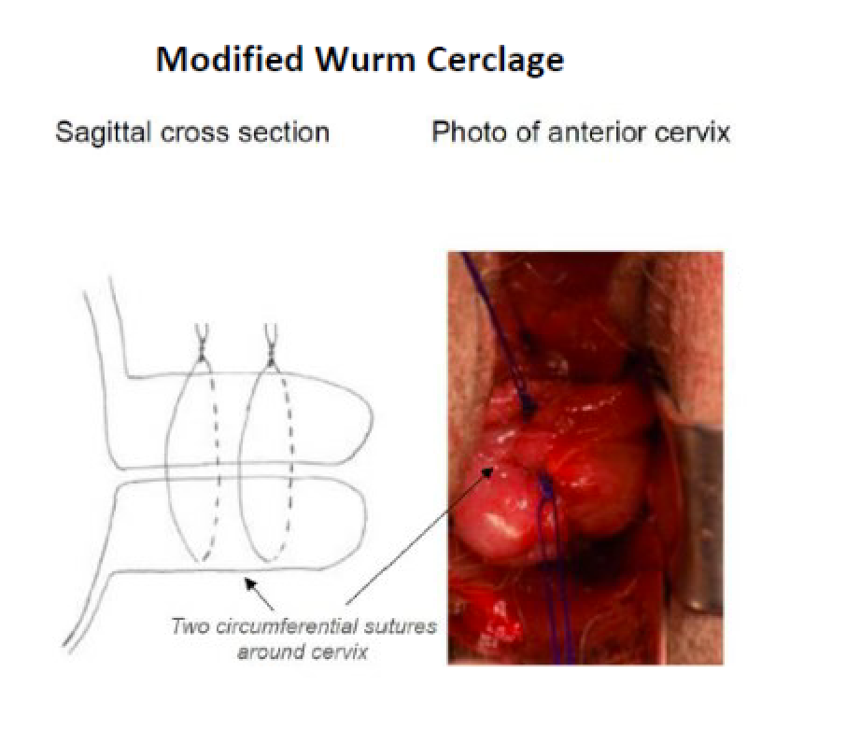
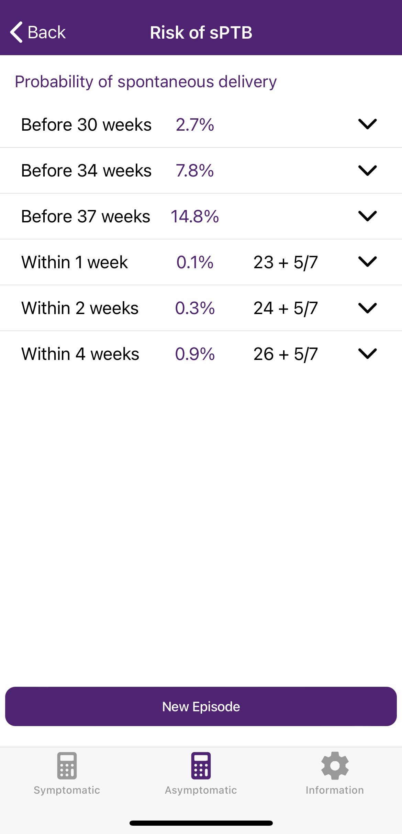

ELCS and cerclage removal
EBL 500 mL
Male BW 2860g well
Cervical length (mm)
Gestational age (weeks)
12 14 16 18 20 22 37
Progesterone 200mg ON
Notes:
X 2 Prolene sutures
22+5 ffn 3ng/ml
Follow up Perinatal History clinic

Slide 3

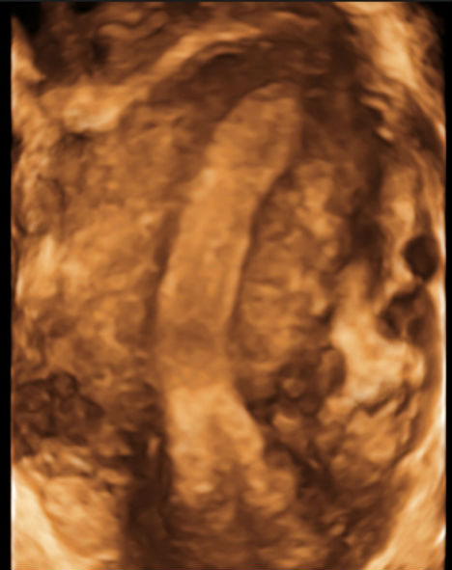
Background
Methods
Prospective 10-year study of pregnant women diagnosed with unicornuate uterus who had antenatal surveillance in the UCLH PTB clinic between 2010 and 2021.
All women underwent serial transvaginal ultrasound assessment of cervical length in the second trimester of pregnancy.
Maternal demographics and pregnancy data were collected. The primary outcome was spontaneous PTB.
Statistical analysis was performed using IBM SPSS v27 to assess the impact of individual clinical variables on gestational age at delivery.
Congenital uterine anomalies affect up to 1% of all pregnant women and are associated with late miscarriage and preterm birth (PTB)¹.
Women with unicornuate uterus appear to be at higher risk of complications², although there is limited prospective literature data.
3D Transvaginal ultrasound
image of unicornuate uterus³
Akhtar et al BJOG 2020
Ridout et al AJOG 2019

Slide 4
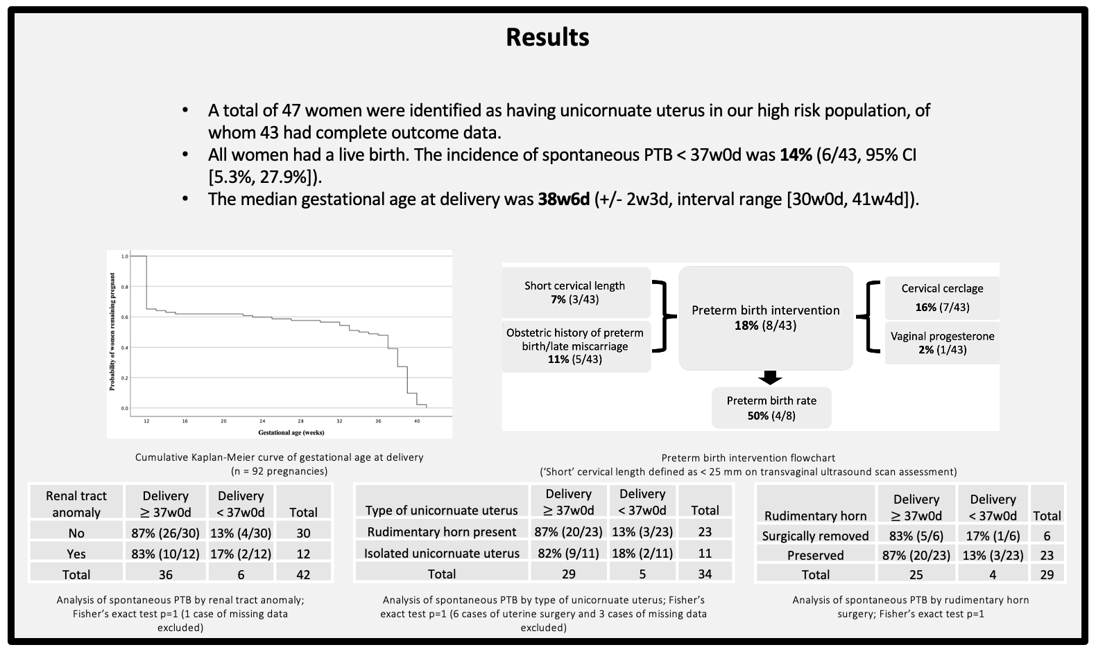

Slide 5
Conclusions
Our results indicate a good pregnancy outcome of women with unicornuate uterus, even in women who underwent preterm birth interventions.
The sample size was small which limits the strength of some conclusions.
We propose a national multicentre study using the UK Preterm Birth Clinical Network.

