Slide 1

North Central London Preterm Birth Network: fFN in asymptomatic women: evidence and cases
UCLH PTBC Team
7/7/2022

Slide 2
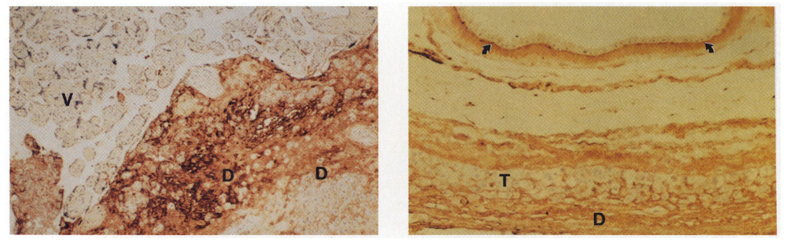
Fetal fibronectin staining by immunohistochemistry
Uteroplacental junction at term has fFN staining in the extracellular matrix of decidua basalis near intervillous space
Amniochorionic membrane and decidua at term. FFN staining is seen in amniotic basement membrane through to decidua
Lockwood et al NEJM 1991

Slide 3
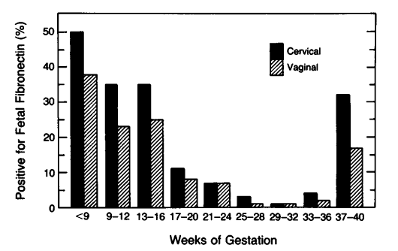
Fetal fibronectin levels in normal pregnancy
Percentage of fFN >50ng/ml in women with uncomplicated pregnancies delivering at term. 163 patients tested on average 4 times during the pregnancy (553 samples)
Lockwood et al NEJM 1991

Slide 4
Where does the 50ng/ml cut-off come from?
ng/ml | Sensitivity | Specificity
25 | 81.7 | 77.7
50 | 81.7 | 82.3
75 | 78.3 | 82.5
117 women with intact membranes and uterine contractions
Lockwood et al NEJM 1991

Slide 5
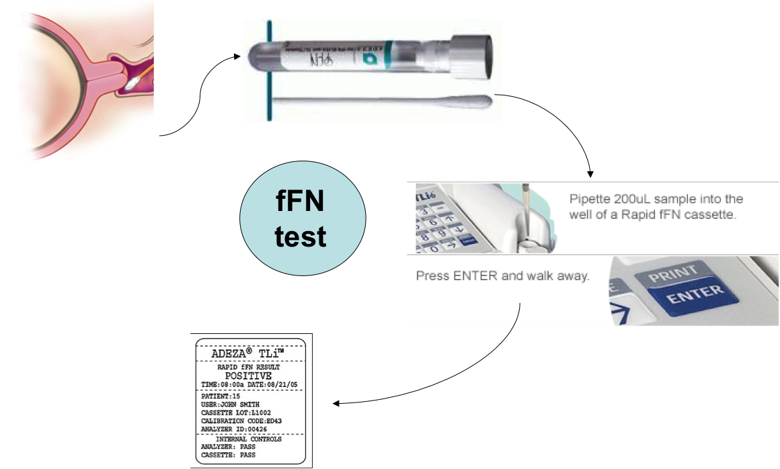
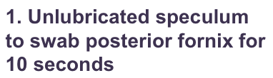
Fetal fibronectin
Actually can lubricate speculum but avoid too much gel!
4. Result in 10 minutes
3. 200mcl fluid in 10Q machine

Slide 6
Remember
Contra-indications ie result not interpretable
Ruptured membranes
Placenta previa
Placental abruption
Moderate or gross vaginal bleeding
All these situations can cause a false positive result
Within 24 hours of sexual intercourse (approximate double the level)
Cervical cerclage (within 4 weeks of surgery)

Slide 7
What is the effect of cervical manipulation or sexual intercourse on fFN results?
Cervical manipulation in the previous 24 hours via transvaginal ultrasound or sterile vaginal examination does NOT significantly affect fetal fibronectin results
Patients reporting sexual intercourse within 24 to 48 hours are more likely to have a positive fFN result than women who have not had recent sexual intercourse (39.7% vs 7.1%; relative risk, 5.6; 95% confidence interval, 3.0-10.6)
Levy AT, Quist-Nelson J, Berghella V. The effect of transvaginal ultrasound, vaginal examination, or coitus on fetal fibronectin results: individual participant data from 6 cohort studies. Am J Obstet Gynecol MFM. 2020;2(4):100170.

Slide 8
What is the effect of cervical cerclage on fFN results?
One study performed serial fFN testing every 2 weeks in a cohort of women with cervical cerclage in situ.
The negative predictive value for delivery within 2 weeks of a level <50ng/ml was 97% with a positive predictive value of 16.3%.
There was a higher false positive rate if the fFN test was performed within 4 weeks of cervical cerclage placement
Duhig K, Chandiramani M, Seed P, Briley A, Kenyon A, Shennan A. Fetal fibronectin as a predictor of spontaneous preterm labour in asymptomatic women with a cervical cerclage. BJOG An Int J Obstet Gynaecol 2009 May;116(6):799–803.

Slide 9
Qualitative fFN – the original test

Slide 10
fFN @ 24 weeks
The value of qualitative fetal fibronectin
in asymptomatic high risk women
Delivery at < 30 weeks < 34 weeks < 37 weeks
24 week test (n=146) (n=144) (n=137)
Sensitivity (%) 75 54 25
Specificity (%) 95 95 95
PPV (%) 46 54 58
NPV (%) 98 95 83
Shennan et al 2005 BJOG 112; 293-8

Slide 11
fFN @ 24 weeks
Shennan et al 2005 BJOG 112; 293-8

Slide 12
fFN at 24/40 as a predictor of delivery before 30 weeks gestation
1
.75
Sensitivity
.5
.25
0
0
.25
.5
.75
1
1 - Specificity
Area under curve = 0.9390 se(area) = 0.0288

Slide 13
Quantitative fFN –what we use now

Slide 14
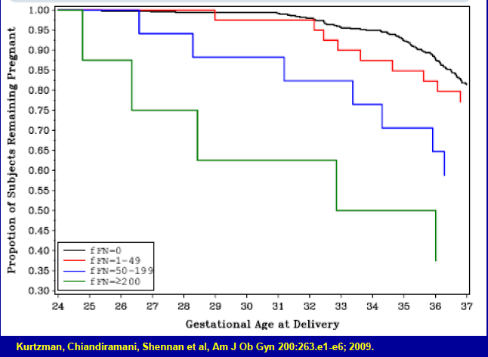
The value of quantitative fetal fibronectin levels
Quantitative fFN in high risk pregnancies

Slide 15
EQUIPP study
Does fetal fibronectin and cervical length predict preterm birth in high risk women?
Validated QUIPP App now available for use clinically from the App store
Abbott et al 2015

Slide 16
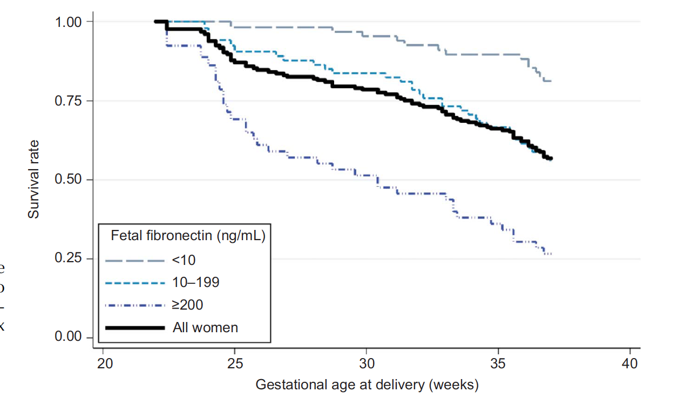
Quantitative fetal fibronectin in asymptomatic high risk pregnancies
Abbott et al Obstet Gynecol 2015

Slide 17
QUIPP App

Slide 18
Advantages of using quantitative fFN
Give more accurate figures about risk of PTB
Avoid unnecessary steroids, admission etc
Tailor treatment (eg tocolytics, MgSO4) to patient
Used in Preterm Birth clinic to give values for women on their risk of preterm delivery

Slide 19
FFN testing – UCLH Audit of PTBC 2017-2018
Greatest value lies in its high negative predictive value
Sensitivity 45.00% 23.06% to 68.47%
Specificity 90.43% 85.61% to 94.06%
Positive Predictive Value (*)31.03% 19.19% to 46.02%
Negative Predictive Value (*)94.50% 92.02% to 96.24%
Accuracy (*) 86.46%
81.34% to 90.61%
FFN <= 50 NPV 94.5% for SPTB
FFN <=200 NPV 95.5% for SPTB < 34 weeks
FFN | 0-50 | 51-200 | 201-500
SPTB | 11 | 7 | 2
Term | 189 | 16 | 4
% PTB | 5.5 | 30.4 | 33.3
Notes:
its greatest value lies in its high negative predictive value
Sensitivity 45.00% 23.06% to 68.47%
Specificity 90.43% 85.61% to 94.06%
Positive Predictive Value (*)31.03% 19.19% to 46.02%
Negative Predictive Value (*)94.50% 92.02% to 96.24%
Accuracy (*)86.46%81.34% to 90.61%

Slide 20
FFN testing – UCLH Audit of PTBC 2018-2019
FFN (ng/mL) | 0-50 | 51-200 | 201-500
sPTB | 17 | 5 | 3
Term | 149 | 7 | 0
37 weeks
34 weeks
28 weeks
Sensitivity 32%
Specificity 95%
PPV 53%
NPV 90%
P < 0.001
Notes:
180 FFN test results (iatrogenic deliveries were excluded from analysis)
Sens, spec, NPV and PPV were calculated using a FFN cut-off value of 50 and PTB cut off < 37/40

Slide 21
Case CI
35 yrs
White, BMI 18.8, Non-smoker
PMHx: nil
PSHx: x1 LLETZ
DHx: nil
Obs Hx:
Gravida: 3. Para: 1 + 1 (early misc)
2016 – SVD 38w2, ultrasound indicated cerclage inserted at 14w0 (CL 22m at 13 weeks)

Slide 22
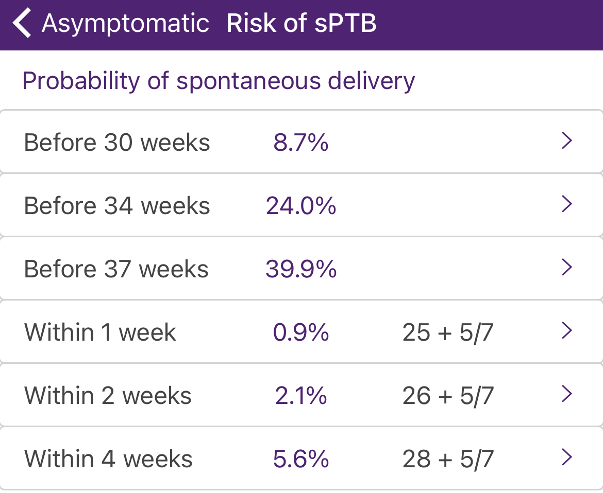
PTB surveillance in subsequent pregnancy
USU 11w3 – CL 33mm. CST – low risk. Normal PAPPA.
PTBC 12w5 – CL 31mm, Cerclage discussed.
13w3 – History indicated McDonald cervical cerclage
PTBC 16w5 – CL 31mm, lower back pain since cerclage. Cervix was closed above and below cerclage. Urine culture – NAD.
PTBC 16w5 – CL 25mm.
USU 21w0 – CL 25mm. Normal anomaly scan.
PTBC 22w5 – CL 32mm. fFN 348ng/ml. Asymptomatic. Some blood noted on swab. Urine culture- NAD
PTBC 24w5 – CL28mm, fFN 315ng/ml. Asymptomatic.
Discussion: Hold steroids as risk of sPTB <10% in next 4 weeks. To attend MFAU if any symptoms of PTL.

Slide 23
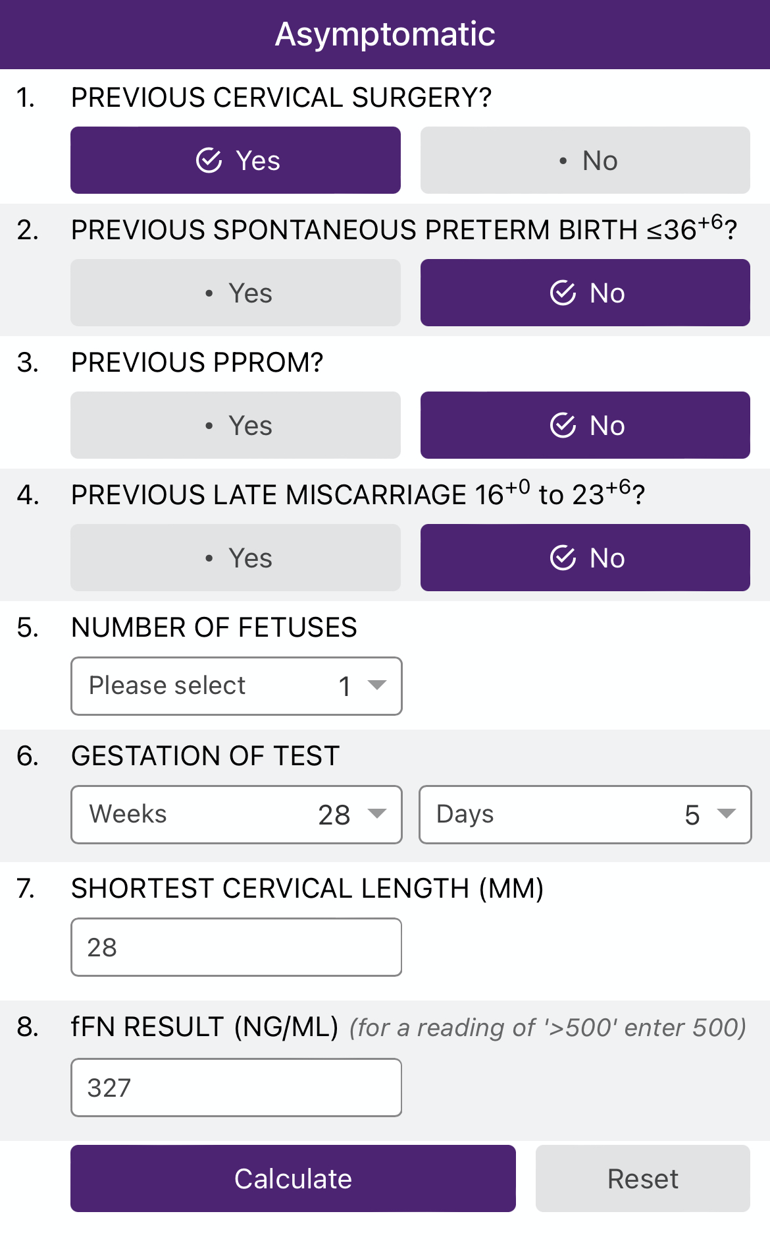
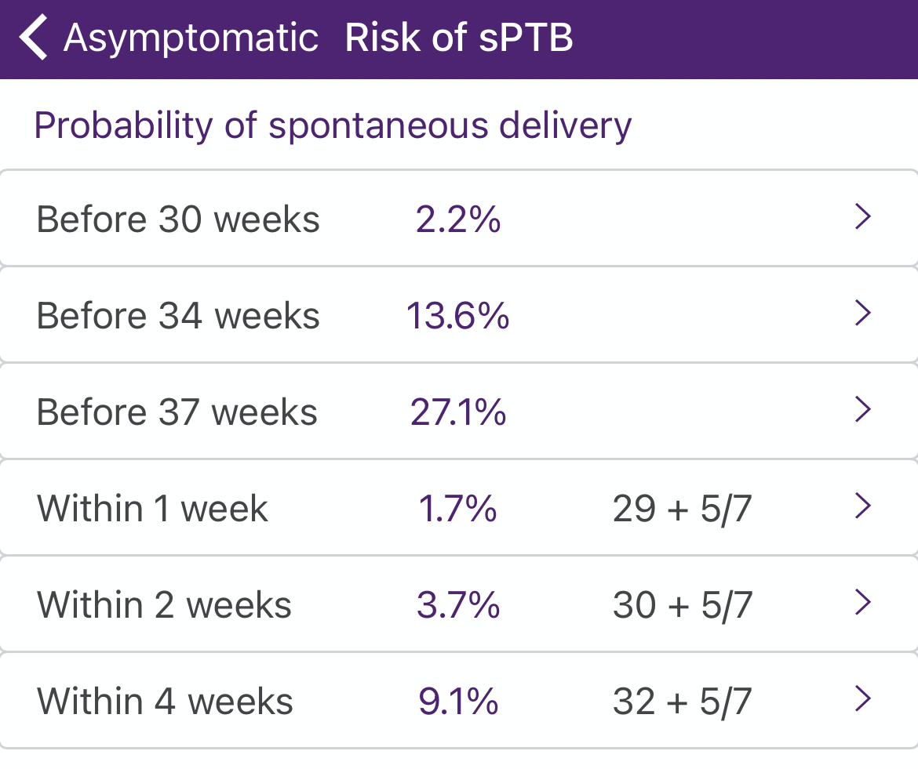
PTBC 28w5 – CL28mm, fFN 327ng/ml. Asymptomatic. Plan: PTBC 2 week. Urine culture – NAD. Vaginal swab - NAD
MFAU 30w1- Admitted following SROM. EFW noted at 3rd centile.
LW 30w5 – EmCS due to pathological CTG.
Cultures -NAD

Slide 24
Case OM
38 yo White British BMI 22 Non-smoker
PMHx: nil
Smears UTD, normal
DHx: vitamins
Obs Hx: G4 P2 + 2
  2012 40w EMCS at 8cm for fetal distress
  2013 Early miscarriage – surgical management
  2014 38w FD, OASI 3b perineal tear (no cervical tear)
  2016 20w Late miscarriage: large bleeding and subchorionic haematoma in the 1st trimester; increased PV discharge and PPROM at 20w; IOL; no PM exam

Slide 25
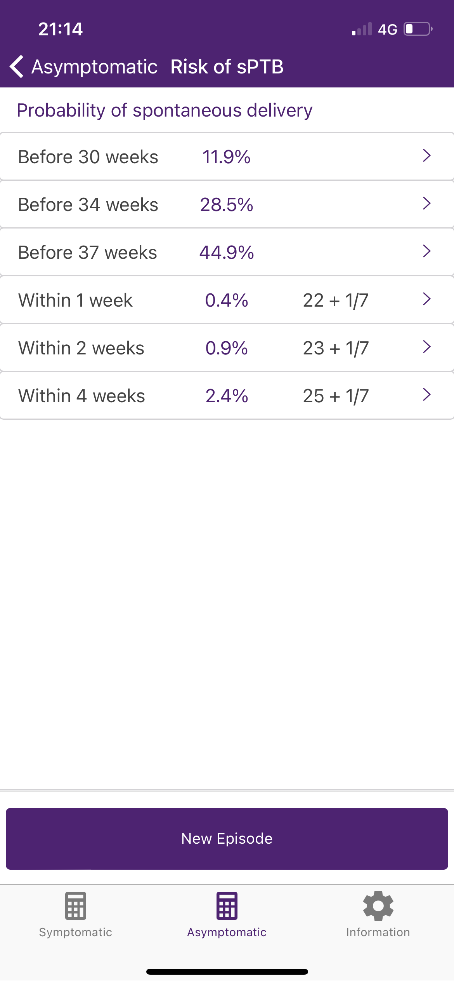

Case OM
PTBC 17w CL 31 mm, asymptomatic
  UTI at booking – treated by GP
PTBC 19w1d CL 37mm, asymptomatic
  Vaginal swabs - NAD
  UTI E Coli - treated (subsequent negative TOC)
Anomaly scan 21w0d CL 15mm
PTBC 21w1d CL 15 mm, asymptomatic
  Funnelling, fFN 15ng/mL, urine negative
  emergency cervical cerclage (McDonald) and
  Progesterone treatment

Slide 26
Case OM
PTBC 24w1d CL 28mm, asymptomatic
Cervix closed below and above the cerclage
PTBC 27w1d CL 24mm, asymptomatic, fFN 58ng/mL
Cervix closed 6mm above and 18mm below the cerclage
Plan for follow up in 2 weeks
MFAU 29w0d CL 11mm, symptomatic (abdominal pain and increased PV discharge), fFN 354ng/mL
Normal fetal growth, Dopplers and AFI
Admitted to LW (steroids, MgSO4)
LW 29w1d PPROM cervical cerclage was removed, vaginal delivery baby boy BW 1300 g well
Completed 5 days of iv abx (cervical cerclage grew E coli)
Placental histology: acute chorioamnionitis and funisitis
Notes:
Quipp app not used as cervical cerclage in situ

Slide 27
Case - FA
31yrs
African, BMI 23.3, Non-smoker
Spontaneous conception
PMHx: FGM
PSHx: Caesarean Section x1
Obs Hx:
Gravida: 5. Para: 3 +1 (early misc)
2009 - 40 weeks EMCS at full dilatation for pathological CTG, 3700g
2011 - 24 weeks SVD, 550g
2013 - 24 weeks SVD, 585g

Slide 28
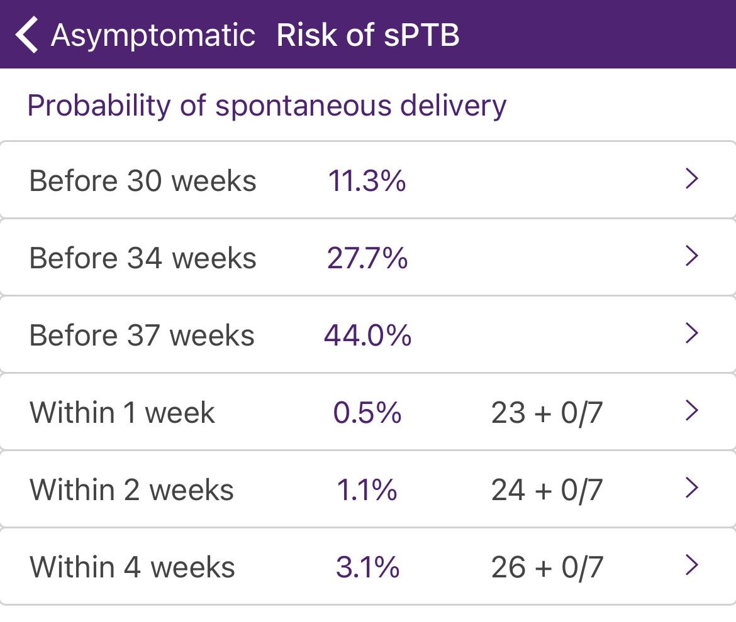
PTB surveillance in subsequent pregnancy
USU 13w0 - CL 29mm
PTBC 15w - CL 26mm
  x2 previous pregnancies with sudden onset labour at 24 weeks - no preventative intervention.
  Option of cervical cerclage discussed
16w0 - McDonald cervical cerclage (Mersilene tape)
PTBC 18w0
  CL 35mm, CS scar noted to be just above level of internal os.
USU 21w1 - Normal anomaly scan. CL 29mm
PTBC 22w0 - CL 32mm (22mm below cerclage), fFN 145ng/ml, asymptomatic.
  Vaginal swab - Streptococcus Group C (Abx given)
  Urine culture - NAD

Slide 29
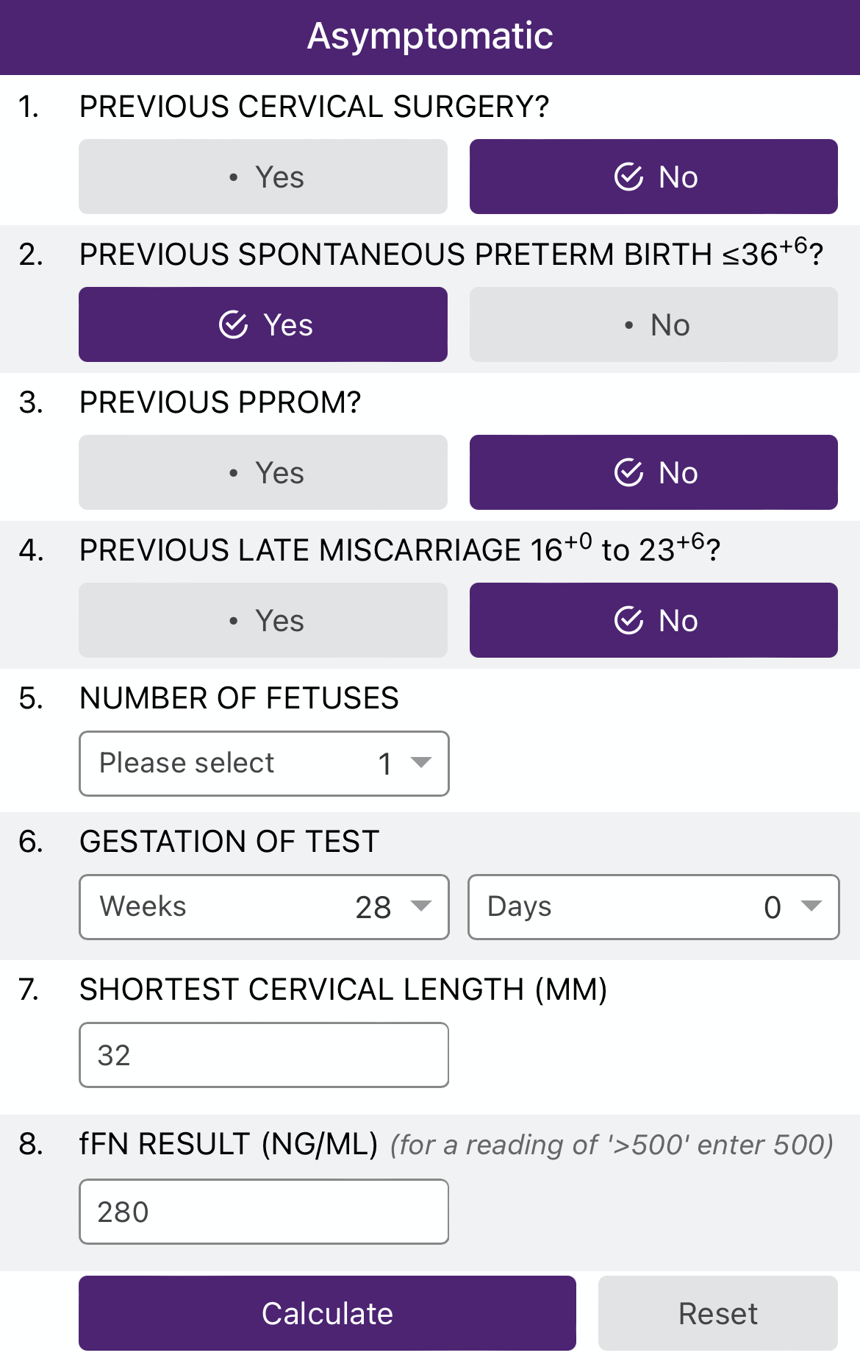
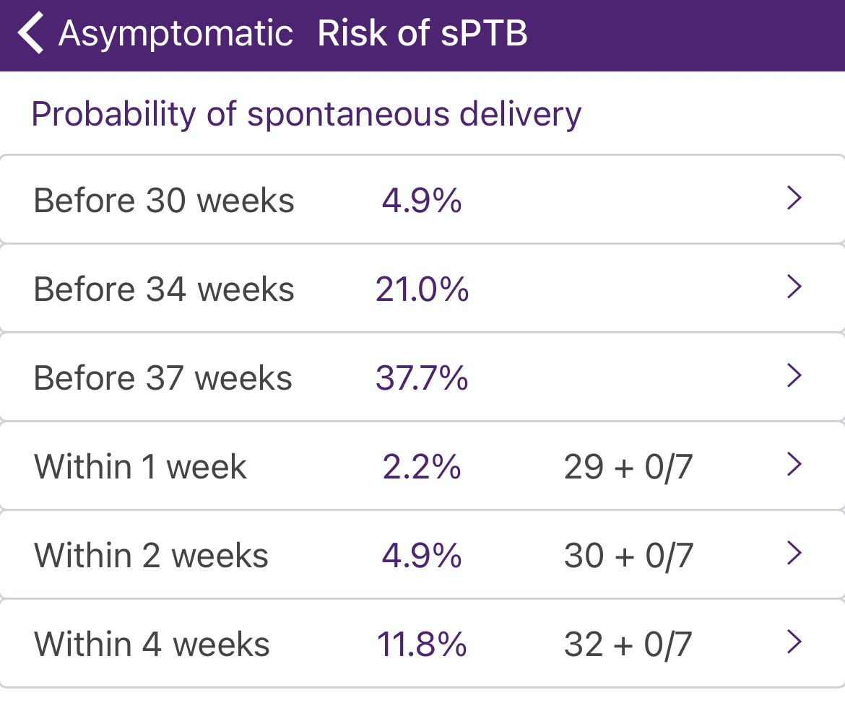
PTBC 24w0 - CL 34mm, asymptomatic
  Urine culture -Citrobacter koseri (Abx given)
PTBC 26w0 - CL 23mm, noticed occasional mild tightening symptoms following standing for long periods. Started on progesterone
PTBC 28w0 - CL 32mm, fFN 280ng/ml
PTBC 30w0 – CL 26mm
  Urine culture – NAD
  Discharged from PTBC
LW 41w1 – Spontaenous onset of labour and EmCS due to pathological CTG.

Slide 30
Thanks to UCLH Preterm Birth team
Raf Napolitano
Davide Casagrandi
Amos Tetteh
Natalie Greenwold
Amrita Banerjee
Maria Ivan
Debbie Warner
Georgie Fox
FMU midwives

