Slide 1

Helping Primary Care teams to support patients

Slide 2



Housekeeping
We are using Zoom webinar so your camera and mics will not be captured
This session is being recorded and will be circulated after the meeting
Please use the Q&A box if you have any questions or comments
Notes:
Hello and welcome everyone for joining. For this session today we are using Zoom webinar, there are currently (READ OUT NUMBER OF ATTENDEES ON CALL).
This event will be recorded and circulated after the meeting. Please do not use the chat function, if you have a question or comment put it in the Q&A box and we will do our best to respond to these at the end. We will also be circulating a poll for any feedback at the end of the call.

Slide 3

CVD Prevention - a Population Health Priority in England
The Historic Challenge
The High risk conditions for CVD (AF, Blood Pressure, Cholesterol)
  Under diagnosis
  Sub-optimal treatment is common
  Variation in care
The NHS Long Term Plan 2019
“We will prevent 150,000 heart attacks, strokes and cases of dementia by optimising the diagnosis and management of high blood pressure, high cholesterol and atrial fibrillation”

Slide 4
Proactive Care in the Pandemic
COVID-19 impact in primary care
Overnight transformation
New models of remote care and reduced face to face access
Disruption of routine, proactive care
Risk of deterioration/exacerbation/complication in people with non communicable diseases – eg CVD, hypertension, diabetes, COPD
Expected further waves of demand for urgent care primary and secondary care
Urgent need and opportunity

Slide 5




UCLP Proactive Care Frameworks
UCLPartners has developed a series of real world frameworks to support proactive management of long-term conditions in post-COVID primary care.
  Led by clinical team of GPs and pharmacists
  Supported by patient and public insight
Core principles:
Virtual where appropriate and face to face where needed
Mobilising and supporting the wider workforce (including pharmacists, HCAs, other clinical and non-clinical staff)
Step change in support for self-management
Digital innovation including apps for self management and technology for remote monitoring

Slide 6
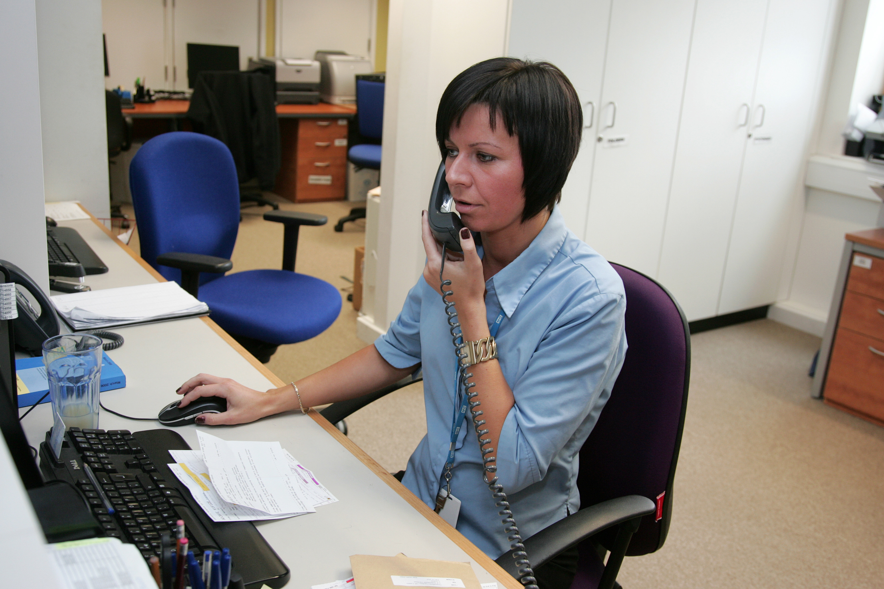
UCLP Proactive Care Frameworks
Conditions included
CVD prevention
Atrial Fibrillation
Blood pressure
Cholesterol
Type 2 Diabetes
Respiratory
Asthma
COPD

Slide 7
CVD High Risk Conditions – Stratification and Management Overview
Healthcare Assistants/other trained staff
Gather information e.g. Up to date bloods, BP, weight, smoking status, run risk scores: QRISK, ChadsVasc, HASBLED
Self management e.g. Education (condition specific, CVD risk reduction), self care (eg red flags, BP measurement, foot checks), signpost shared decision making
Behaviour change e.g. Brief interventions and signposting e.g. smoking, weight, diet, exercise, alcohol​
Risk Stratification & Prioritisation
Atrial Fibrillation
Blood Pressure
Cholesterol
Diabetes
Prescribing Clinician
Optimise therapy and mitigate risk
Review blood results, risk scores & symptoms
Initiate or optimise therapy
Check adherence and adverse effects
Review complications and co-morbidities
CVD risk – BP, cholesterol, pre-diabetes, smoking, obesity

Slide 8
UCLP Proactive Care Frameworks
The Frameworks
Comprehensive GP search tools to risk stratify patients
Pathways that prioritise patients for follow up, support remote delivery of care, and identify what elements of LTC care can be delivered by staff such as Health Care Assistants and link workers.
Scripts and protocols to guide Health Care Assistants and others in consultations.
Training for staff to deliver education, self-management support and brief interventions. Training includes health coaching and motivational interviewing.
Digital and other resources that support remote care and self care.
The UCLP Proactive Care Frameworks focus on
The HOW of doing things differently

Slide 9
High Blood Pressure

Slide 10
High Blood Pressure Stratification and Management
PRIORITY ONE:
Clinic BP ≥ 180/120mmHg**
PRIORITY TWO:
Clinic BP ≥ 160/100mmHg**
Clinic BP ≥ 140/90mmHg** if BAME AND relevant co-morbidity/risk factor*
No BP reading in 18 months
PRIORITY THREE:
Clinic BP ≥140/90mmHg** if under 80 years
OR Clinic BP ≥150/90mmHg** if 80 years and over
PRIORITY FOUR:
Under 80 years
Clinic BP < 140/90mmHg**
80 years and over
Clinic BP < 150/90mmHg**
Ask patient for up-to-date home BP if available: adjust priority group if needed (as above)
Review by Prescribing Clinician
Review by HCA or other staff role
Review results and CVD risk
Investigations as needed: Renal, lipids, ACR, ECG
If existing CVD or QRisk > 10% support behaviour change and optimise lipid lowering therapy
Review medication:
Identify and address adherence issues – refer to practice pharmacist if additional support required
Optimise BP medications, in line with NICE guidance
Seek specialist advise
If BP uncontrolled on four antihypertensives and no adherence issues identified
Multiple drug intolerances
Hypertension in young person requiring investigation of secondary causes
Advise
When to check BP and submit readings (e.g, monthly until controlled, then every 3 months)
When to seek help based on BP readings
Book follow up and code
Self management and behaviour change support
Check BP taking technique
Share resources to help understanding of high blood pressure, CVD risk and treatment
CVD prevention brief interventions – diet / exercise / smoking / weight / alcohol
Signpost tools and resources
Medication:
Check if any issues / concerns regarding medicines – refer to practice pharmacist for meds review / adherence support, if needed
Confirm supply / delivery
Advise
When to submit BP readings (e.g. every 3 months)
When to seek help based on BP readings
Referral
Refer to GP if any red flags identified
If existing CVD or QRIsk > 10% and no statin – refer to prescribing clinician
Recall and code
Review by HCA or other staff role
Support for self management and behaviour change
Check BP taking technique
Check if existing CVD or QRisk >10% and not on statin (refer to prescribing clinician)
Share resources to help understanding of high blood pressure, CVD risk and treatment
CVD prevention brief interventions – diet / exercise / smoking / weight / alcohol
Signpost tools and resources
* / ** see slide 9

Slide 11
Home Blood Pressure Monitoring Pathway
Confirmed AF diagnosis
No BP monitor
Patient has BP monitor
(confirm by text)
Advise patient to buy a BP monitor (see slide 5) or
Local scheme to supply BP monitor
Patient obtains BP monitor
Phase over time
Advise patient to check if approved monitor (Text link) and confirm < 5 years old
Pulse irregular or patient uncertain
Phase over time
Wellbeing staff to teach BP technique & pulse check technique (with video resources)
No BP monitor
Detection of AF
Remote (eg Fibricheck or mobile ECG device)
Face to face pulse/ECG
No AF
AF confirmed
Local pathway to check and manage BP in AF – see slide 10
Assess for anticoagulation and manage AF in line with local pathways
Home BP readings submitted using locally agreed tool
Face to face BP options
Community pharmacy
GP practice
Other community settings

Slide 12
UCLP Proactive Care Frameworks
Local evidence (PCN level)
Total Population of PCN: 160,000
Hypertension: 20,084
Hypertension using UCLP stratification (PCN Level) |  | Patients | %
Priority 1 | BP >= 180/120mmHg (clinic BP or home equivalent) | 207 | 1%
Priority 2a | BP >= 160/100mmHg | 1063 | 5%
Priority 2b | BP >= 140/90mmHg if BAME with CVD, CKD, diabetes, or BMI >35 | 327 | 2%
Priority 2c | No BP reading in 18 months | 2280 | 14%
Priority 3a | BP >= 140/90mmHg if BAME or CVD, CKD, diabetes | 810 | 4%
Priority 3b | BP >= 140/90mmHg - all other patients | 686 | 3%
Priority 4a | BP < 140/90mmHg (under 80 years) | 9650 | 46%
Priority 4b | BP < 150/90mmHg (80 years and over) | 2310 | 11%

Slide 13
UCLP Proactive Care Frameworks
Supporting John to manage hypertension
HISTORY
56 year old male, Black Caribbean, bus driver
Hypertension diagnosed for 8 years
Poorly controlled and last recorded BP 166/98mmHg (Jan 20)
Currently prescribed amlodipine and indapamide – but not collecting regularly
Last recorded BMI = 28.5
Not on statin
ACTIONS
Priority group 2
HCA to collate relevant info – BP readings, will need bloods, recent weight, if available, calculate QRIsk score
Will need review by prescribing clinician, adherence review and medicines optimisation
Follow up support for self management and lifestyle change by HCA
Review in a month with HBPM readings

Slide 14
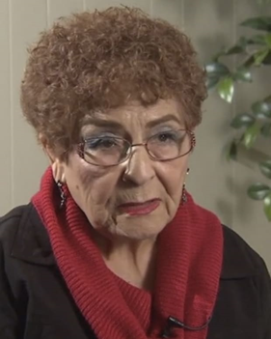
UCLP Proactive Care Frameworks
Supporting Milly to manage multiple conditions
HISTORY
83 year old woman, retired
Hypertension diagnosis 30 yrs +
Diabetes (on metformin)
BP well controlled on CCB/ACE-I
Also on atorvastatin 20mg daily
Generally active
Last recorded clinic BP 148/85mmHg
ACTIONS
Priority group 4
HCA to collate relevant info – BP, will need bloods, recent weight, if available. Check pulse!
If repeat BP < 150/90mmHg (home BP < 145/85mmHg) then no need for prescriber review initially
Contact by HCA / other role to reassure re BP, encourage self management, reassess lifestyle issues and check OK with meds
Any red flags – refer to prescriber
Follow up support for self management and lifestyle change by HCA
Review in a 6-12months with updated BP readings

Slide 15
Cholesterol

Slide 16
Cholesterol – Secondary Prevention (pre-existing CVD)
Healthcare assistants/other appropriately trained staff
Gather information e.g. Up to date bloods, BP, weight, smoking status
Self-management e.g. Education (cholesterol, CVD risk), BP monitors (what to buy, how to use), signpost to shared decision making resources
Behaviour change e.g. Brief interventions and signposting e.g. smoking, weight, diet, exercise, alcohol
Stratification
Priority One
Not on statin therapy
Priority Two (A)
On suboptimal intensity statin*
Priority Two (B)
On suboptimal statin dose**
Priority Three – routine follow up
Sub-optimal non-HDL (>2.5mmol/l) levels despite maximal statin therapy
Prescribing clinician
Optimise lipid modification therapy and CVD risk reduction
Review CVD risk factors, lipid results and liver function tests
Initiate or optimise statin to high intensity – e.g. atorvastatin 80mg
Titrate therapy against reduction in LDLc/non-HDLc (statin>ezetimibe>PCSK9i)
Optimise BP and other comorbidities
Use intolerance pathway and shared decision-making tools to support adherence
Arrange follow-up bloods and review if needed
* E.g simvastatin
** E.g atorvastatin 40mg

Slide 17
Cholesterol – Primary Prevention (no pre-existing CVD)
Healthcare Assistants/other appropriately trained staff
Gather information: E.g. up to date bloods, BP, weight, smoking status, run QRisk score
Self management: Education (cholesterol, CVD risk), BP monitors (what to buy, how to use), signpost to shared decision making resources
Behaviour change: Brief interventions and signposting e.g. smoking, weight, diet, exercise, alcohol
Stratification
Priority One
One of:
QRisk ≥20
CKD
Type 1 Diabetes
AND
Not on statin
Priority Two
QRisk 15-19
AND
Not on statin
Priority Three
QRisk 10-14
AND
Not on statin
Priority Four
On statin for primary prevention but not high intensity
Prescribing Clinician
Optimise lipid modification therapy and CVD risk reduction
Review QRisk score, lipid results and LFTs
Initiate or optimise statin to high intensity – eg atorvastatin 20mg
Titrate therapy against reduction in LDLc/non-HDLc (statin>ezetimide)
Optimise BP and other comorbidities
Use intolerance pathway and shared decision-making tools to support adherence
Arrange follow-up bloods and review if needed

Slide 18
Familial Hypercholesterolaemia Pathway
Case find under 30 years:
TC >7.5 or LDL-C >4.9 or non-HDL-C >6.0
Case find 30 years or over:
TC >9.0 or LDL-C >6.4 or non-HDL-C >7.5
*Simon Broome Criteria
SB 1+2 = Definite FH
SB 1+3 = Possible FH
DRAFT
S/Broome* 1
HCA
Known/coded FH
Fasting lipids plus LFTs, TFTs, Renal, HbA1c
TG <2.3
TG >2.3
Investigate raised TG
Refer if indicated
Text family history questionnaire
1st degree relative MI <60
2nd degree relative MI <50
HCA
Negative
? Tendon Xanthomata
Positive
S/Broome* 3
Positive
S/Broome* 2
PCN Nurse or pharmacist
Face to face or remote assessment
Negative
Refer if not DNA confirmed or if no family testing done
Exclude secondary causes of high TC and refer DNA testing
Unlikely FH: Manage as appropriate for 1º/2º prevention
Aim to reduce non-HDL chol by at least 40%
Support behaviour change, titrate high intensity statins, consider other therapies and manage other CVD risk factors
Nurse/Pharmacist Desktop Review
Nurse/Pharmacist Desktop Review
Not FH
Specialist service
and FH Nurse
Genetic counselling and DNA test
No FH mutation
Treatment in primary care
Confirmed FH
FH: Aim to reduce LDL by 50% or more
Titrate high intensity statins, consider other therapies, support behaviour change and manage other CVD risk factors
FH mutation
Treatment
Cascade testing for family members
Treatment in primary care with specialist support

Slide 19
Atrial Fibrillation

Slide 20
Atrial Fibrillation stratification and management
Healthcare Assistants/other appropriately trained staff
Gather information e.g. Up to date bloods, BP, weight, smoking status, run ChadsVasc, HASBLED, QRISK score​
Self management e.g. Education (AF/stroke risk, bleeding risk, CVD risk reduction), signpost to shared decision making resources.
Behaviour change e.g. Brief interventions and signposting e.g. smoking, weight, diet, exercise, alcohol​
Stratification
Priority One
Not on anticoagulant
Offer anticoagulant if indicated
Priority Two
On anticoagulant & antiplatelet/s
Review need for antiplatelets
Priority Three
On Warfarin
Check TTR for optimal control
Priority Four
On DOAC
Renal function >12m ago
Check CrCl and review dosage
Priority Five
On DOAC
Renal function <12m ago
Routine review
Prescribing Clinician
Optimise anticoagulation therapy and CVD risk reduction
Review: blood results, risk scores & symptoms
Initiate or optimise anticoagulant
Consider switch to DOAC if poor control on warfarin
Check adherence and review any side effects
Review and mitigate bleeding risk: BP control, medication, alcohol, PPI
CVD risk – optimise BP and lipid management, if required

Slide 21
Expert input

Slide 22

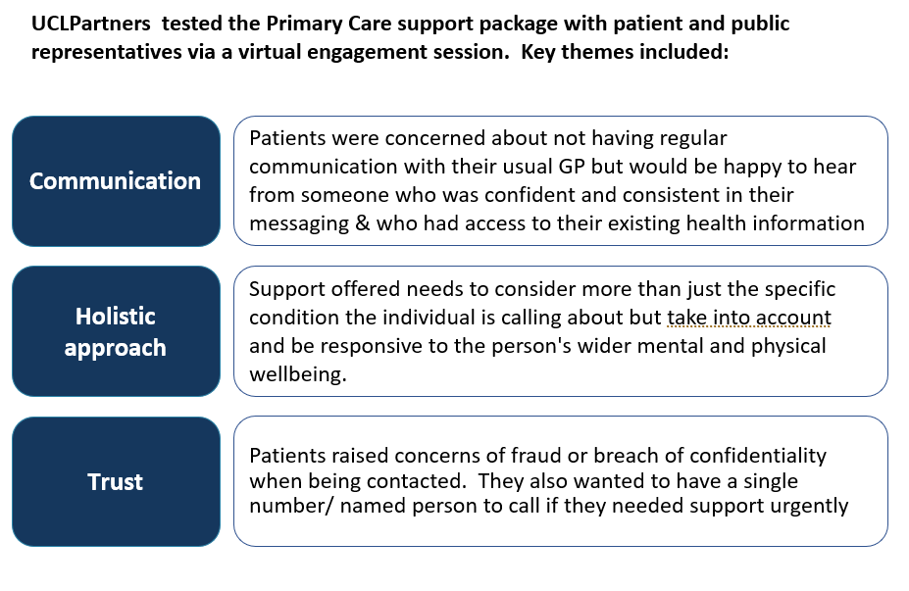
Patient and Public Insight

Slide 23
Clinical Advisory Group
Aiysha Saleemi, Pharmacist Advisor
Dr Deep Shah, GP SPIN
Helen Williams, Consultant Pharmacist
Dr John Robson, Reader in Primary Health care; Clinical Lead Clinical Effectiveness Group
Mandeep Butt, Clinical Medicines Optimisation Lead, UCLPartners
Dr Matt Kearney, GP and Programme Director UCLPartners AHSN
Dr Mohammed Khanji, Consultant Cardiologist, Barts Health NHS Trust
Professor Mike Roberts, Consultant Respiratory Physician and Managing Director UCLPartners
Dr Morounkeji Ogunrinde, GP SPIN
Dr Nausheen Hameed, GP SPIN
Dr Sarujan Ranjan, GP and Health Tech Advisor
Sotiris Antoniou, Lead Pharmacist, UCLPartners
Dr Stephanie Peate, GP
Dr Zenobia Sheikh, GP

Slide 24
Implementation Support

Slide 25
Implementation support is critical
Search & stratify
Comprehensive search tools for EMIS and SystmOne to stratify patients
Pre recorded webinar as to how to use the searches
Ongoing virtual support provided to ensure delivery of the search tools
Workforce training and support
Training tailored to each staff grouping (e.g. HCA/ pharmacist etc) and level of experience.
Delivery:
  Protocols/ wording developed to support staff contact low risk patient
  Virtual training in how to use the protocols, support patient self management and covering motivational interviewing developed by UCLP in partnership with Care City
2. Practical training:
  Video training links, e.g. correct inhaler technique; correct BP technique, Very Brief Advice for smoking cessation, physical activity etc
3. Specialist briefings on the long term conditions – usually delivered by local health system
Digital Support Tools
Digital resources to support remote management and self management FOR each condition
Digital implementation support: how to get patients set up with the appropriate digital tools
Support available from UCLP’s commercial and innovation team for implementation
All underpinned by communities of practice which can be facilitated by UCLPartners

Slide 26
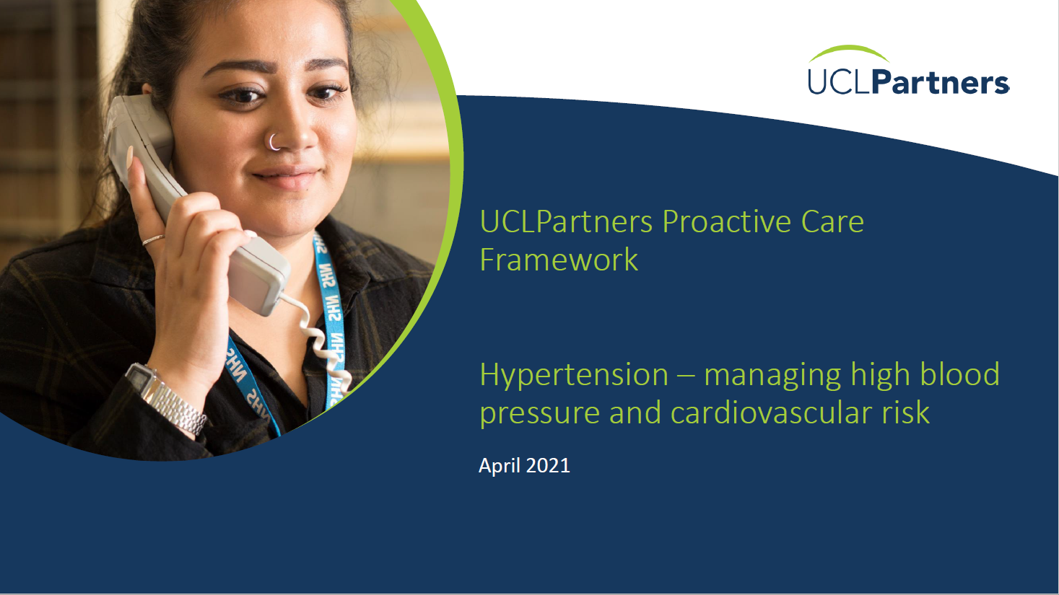
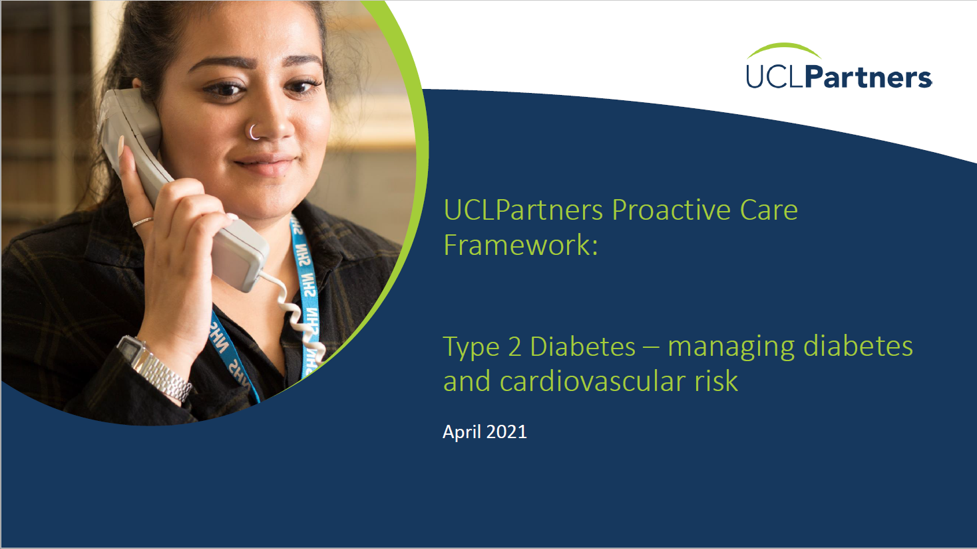
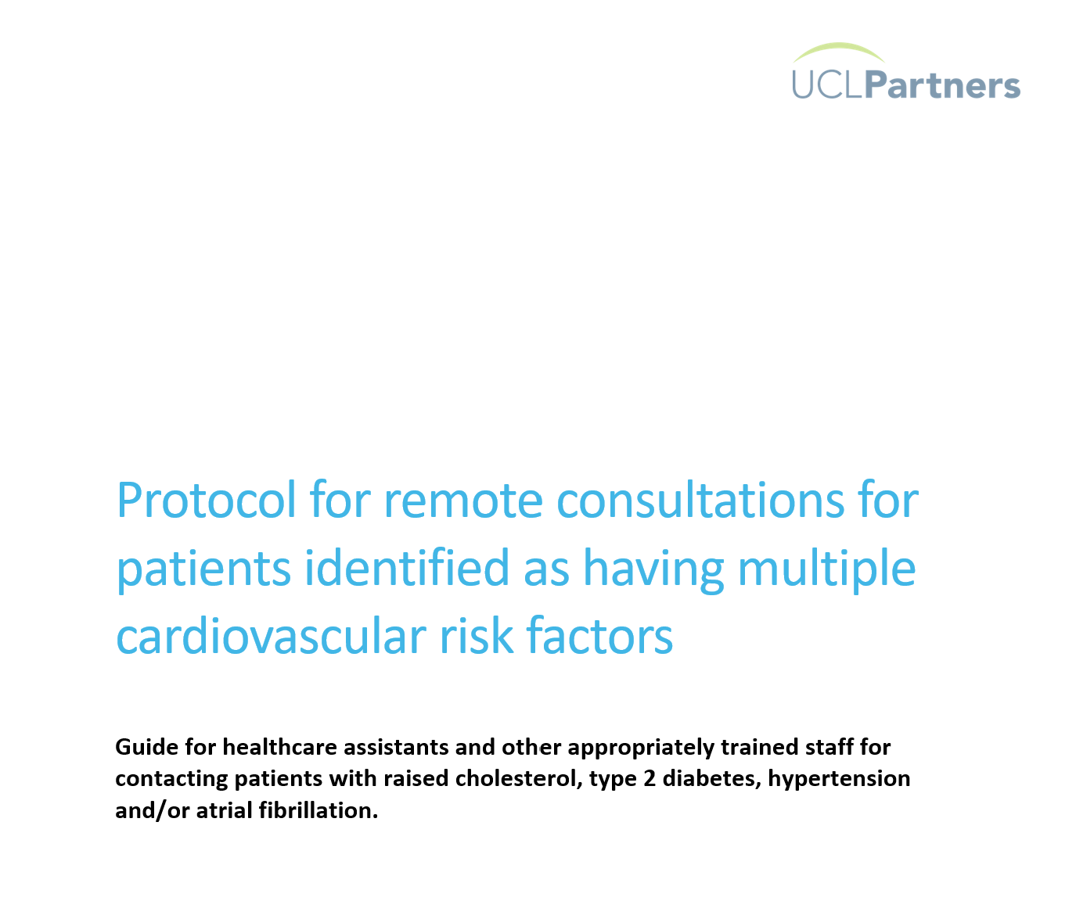
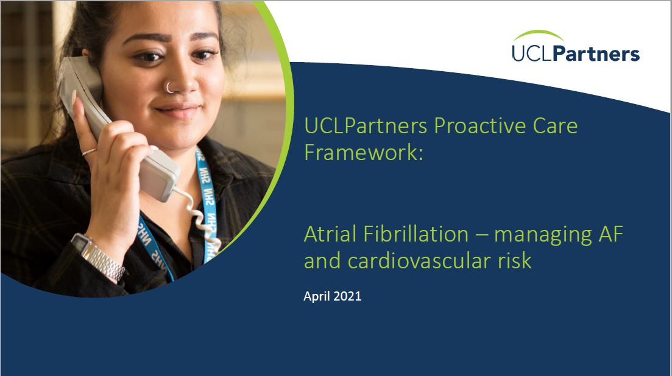
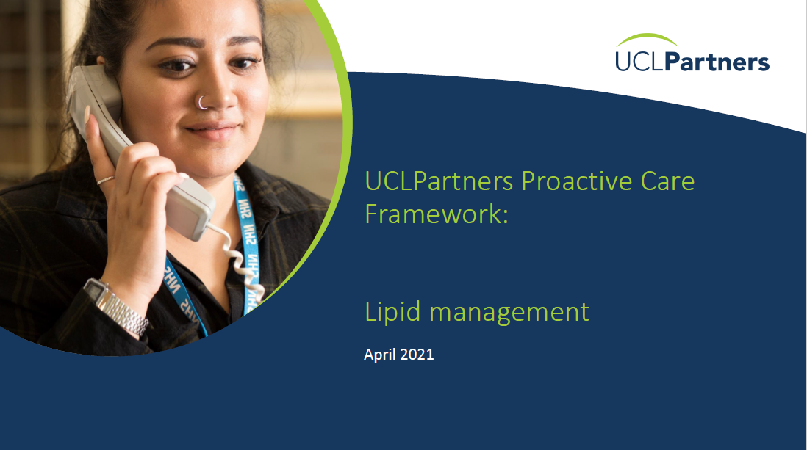
Resources for clinical management – including co-morbidity
Hypertension
T2 Diabetes
Atrial Fibrillation
Cholesterol

Slide 27
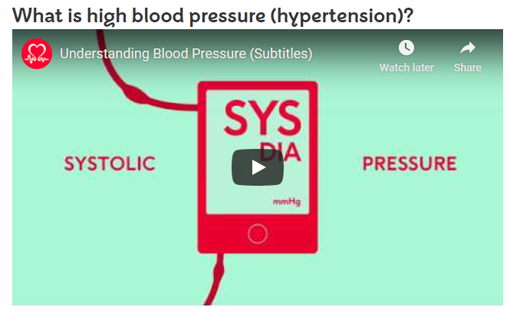
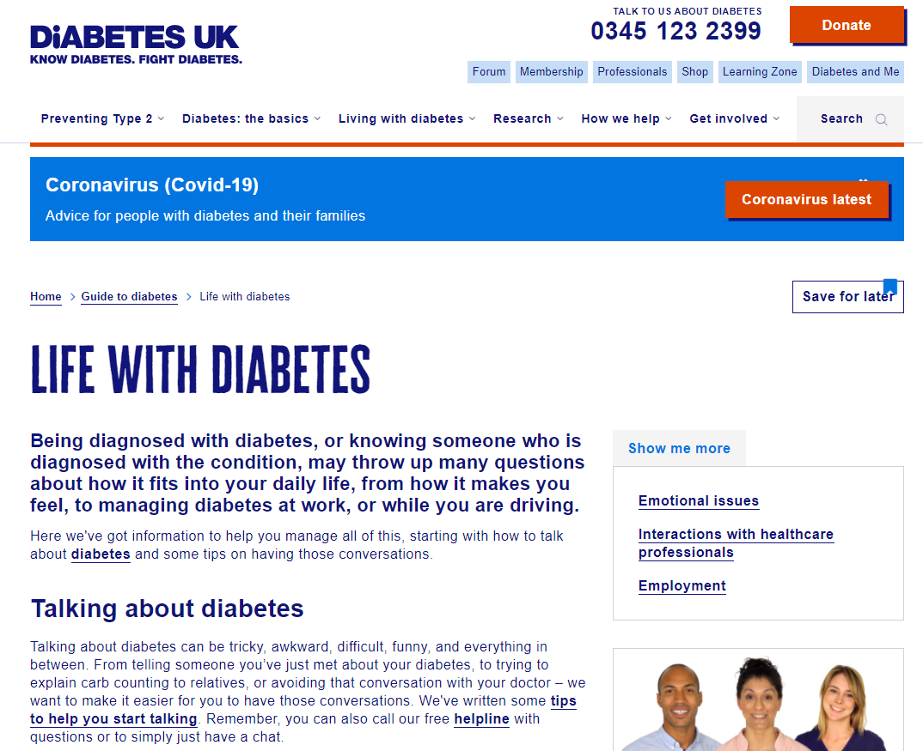
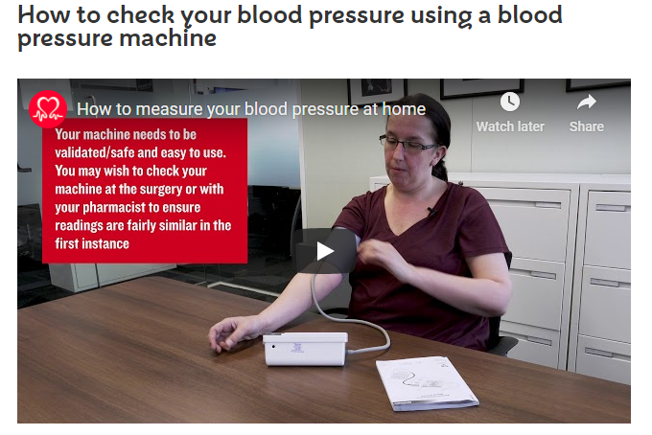
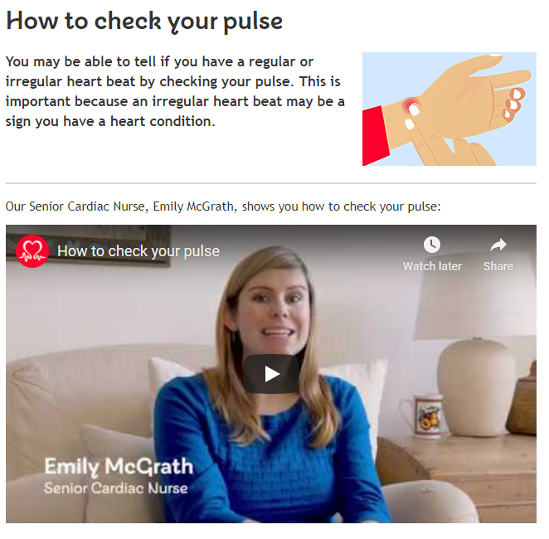
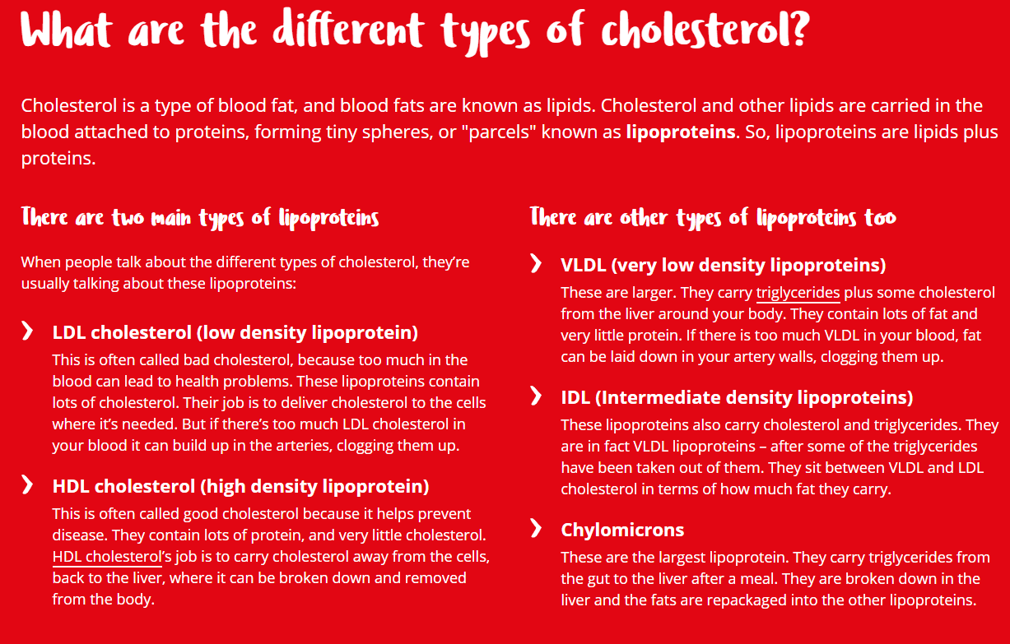
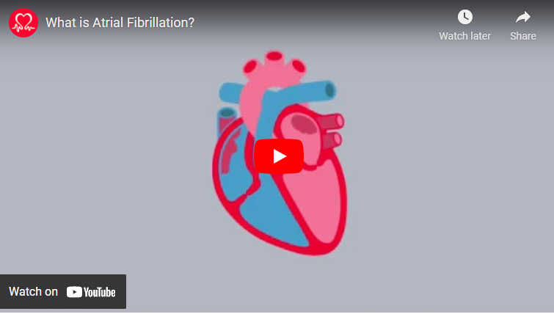
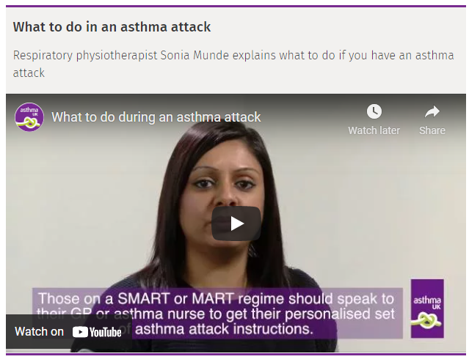
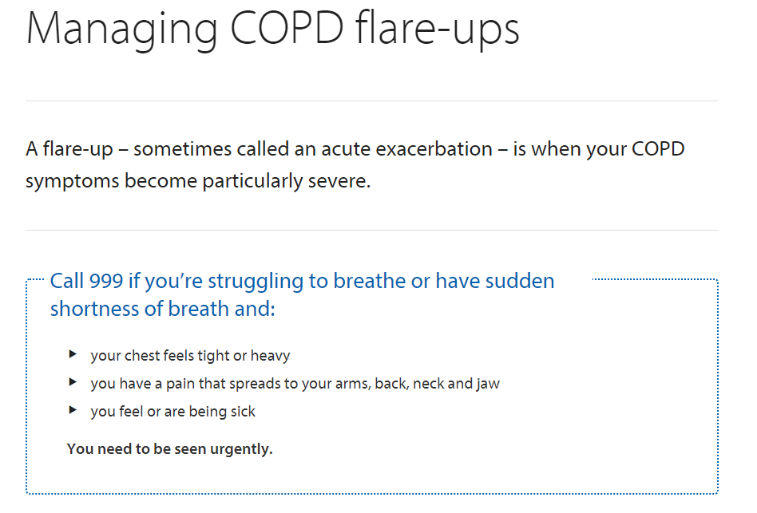
Resources for patients – supporting education and self management

Slide 28
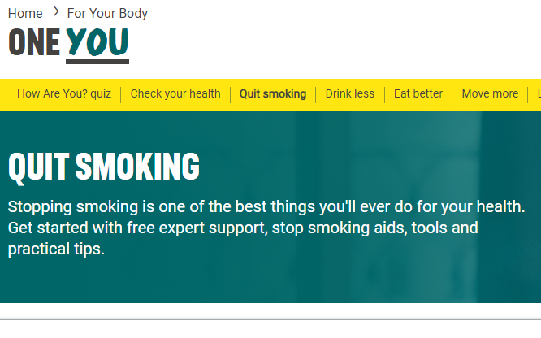
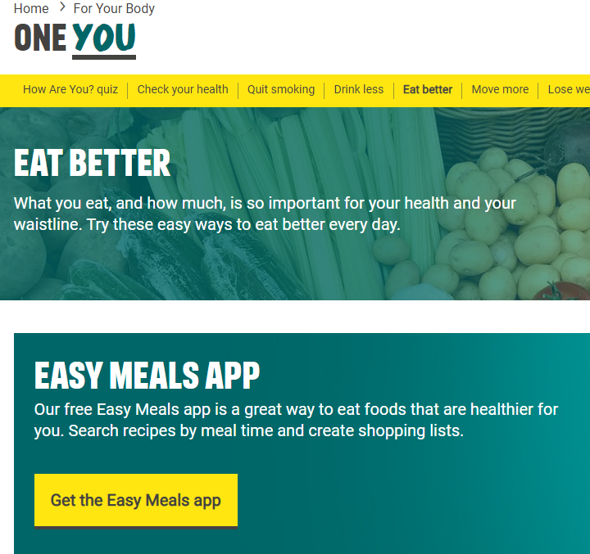
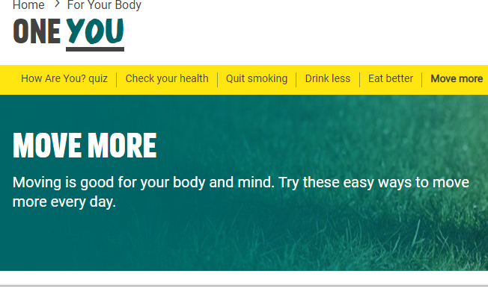
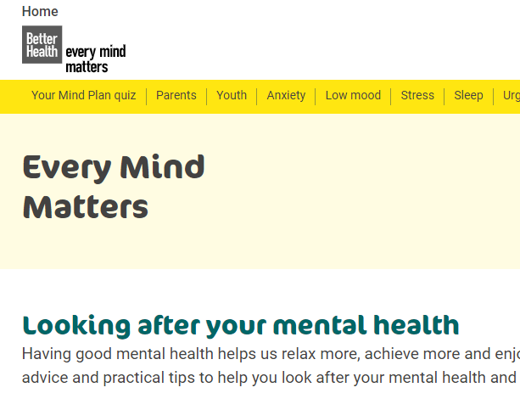
Resources for patients – supporting behaviour change

Slide 29
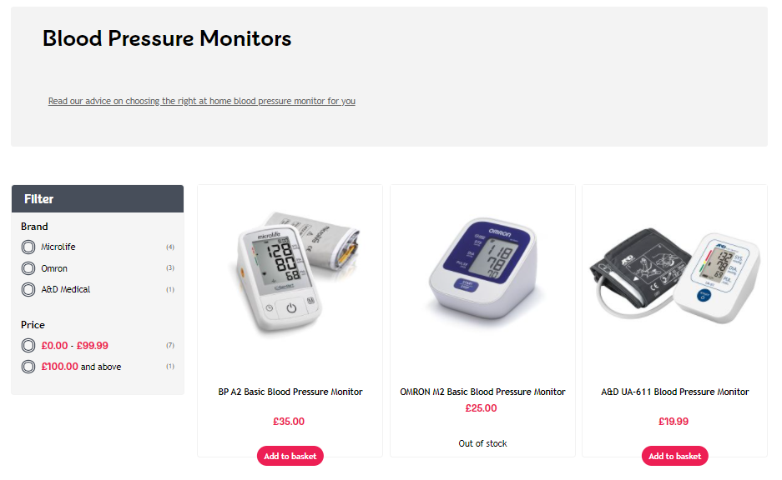
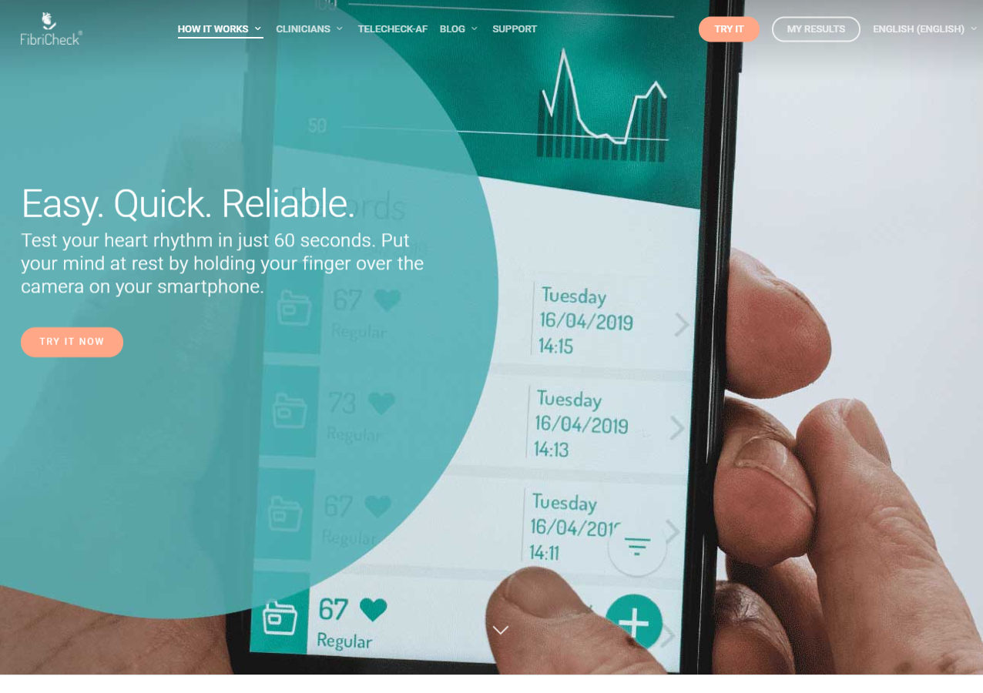
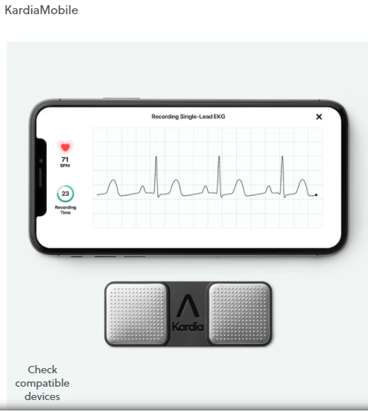
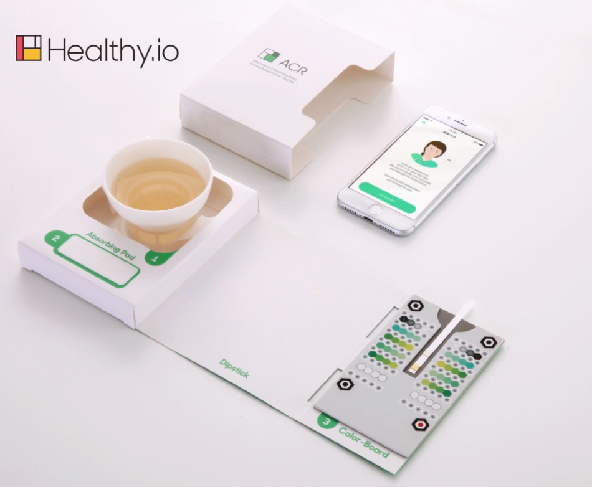
Resources to support remote management
Resources to support remote management

Slide 30
National implementation of the UCLP proactive care frameworks
Resources to support remote management
NHSE/I Pilot Sites – NHS Proactive Care @Home Programme
  North East London
  North Central London
  Cheshire and Merseyside
  Leicester, Leicestershire and Rutland
In addition 6 other AHSNs are supporting local rollout of the UCLP frameworks across the country with over 2,700 downloads of the search tools to date
A national programme evaluation is being commissioned

Slide 31

Free Resources – uclpartners.com/proactive-care/

Slide 32
Q&A

Slide 33


British Heart Foundation
Healthcare professionals
Support tailored to insights we gain from working with the health system:
Healthcare professions newsletter – news, blogs, research, innovation, insights, analysis
Data identifying the prevalence gap and how to reduce this – How can we do better?
Patient information leaflets
Community mobilisation and Blood Pressure funded programmes
BHF Health Systems Insight Team – regional representation across the UK
Patients and the public
Tell
Resources designed around patient/public needs:
User centred
Empathic
Health inequalities – Literacy, health literacy, at risk populations
Promoting health and self-management
Developed with behavioural science
Condition specific information hubs e.g. Manage your BP at home
Heart matters magazine
Health unlocked community
Patient information leaflets
Heart helpline
Contact: Sian Martin – Health Systems Insight Manager. Email – martins@bhf.org.uk

Slide 34
Practical experience using protocols
Carl Jenkins

Slide 35
Some questions for you

Slide 36
Primary.Care@uclpartners.com

