Slide 1
Project Communication Templates
Notes:
Standard title slide

Slide 2
Contents
  Background information: how and when to use this pack​
  Project on a page ​template
  Frequently asked questions​
  Template email A: Request information on clinical use
  Survey template: Understand departmental clinical use
  Template email B: inform staff of transition to a portable cylinder system
  Template email C​: Inform staff of pipeline optimisation
  Posters
Notes:
Plain slide with subhead and bullets

Slide 3
Background information
What: this resource is designed to provide useful information such as a project on a page, FAQs, template emails and posters to aid communication when changing from a medical gas pipeline system to a portable cylinder system, temporarily or permanently. It aims to help keep work on track and ensure internal stakeholders are informed and engaged. Pre-populated headings and placeholder information can be replaced. Resources has been developed using examples from trusts who have completed nitrous oxide waste reduction initiatives.​
Who: this resource is intended for project managers. It is also useful for pharmacy, anaesthetics, estates and facilities colleagues working on nitrous oxide waste initiatives.
​
When: transitioning from a medical gas pipeline system to a portable cylinder system, temporarily or permanently. The posters at the end of this pack can also be used once a portable cylinder system is in place, containing information on clinical best practice when using a portable cylinder system. ​
This resource can be used independently or with the Nitrous Oxide Waste Reduction Toolkit.​
Notes:
Plain slide with subhead and bullets

Slide 4
Project on a page: [insert your project name here]
Background info:
Nitrous oxide is responsible for the largest overall volume of emissions from anaesthetic and medical gases, accounting for at least 75% of total anaesthetic and medical gas emissions in 2019/20. Efforts to reduce the total contribution of the gas across multiple trusts has revealed that waste is a significant problem and needs to be addressed.
Aim:
Reduce waste [nitrous oxide or nitrous oxide/oxygen mixture] by [insert litres and/or carbon dioxide equivalent] by [dd/mm/yyyy], in [insert clinical location(s)].
Objectives:
Decommission supply in areas of no clinical use
Establish portable cylinder systems in areas of low clinical use
Decide upon most effective approach in areas of high clinical use and roll-out. Consider using a portable cylinder system, repositioning a manifold to sit closer to clinical area(s) that use it, or optimising an existing medical gas pipeline system.
Key performance indicators (KPIs) The below is indicative, it may not reflect KPIs for projects and trusts accurately, it can be updated.
KPI | Definition | Baseline | Target
Reduction in carbon footprint (tC02e) | Overall reduction in tCO₂e from nitrous oxide waste
Access to portable cylinder system | No. of portable cylinder systems set up
Removal of medical gas pipeline system | No. of manifolds/manifold branches decommissioned No. clinical areas no longer using medical gas pipeline system
Reduced procurement of large nitrous oxide cylinders | Reduction in count of large size G or J cylinders coming into and out of the hospital
Increased procurement of a smaller nitrous oxide cylinders aligned to clinical need | Increase in count of smaller size E or F cylinders coming into and out of the hospital
Scope:
In scope: [insert hospital site], reducing [insert type of gas] waste, [insert clinical area/s]
Out of scope: [insert hospital site], [insert other clinical area/s], ambulance and community stock and use, removing the gas from use
Example timeline:
The below is indicative, it may not reflect work and timelines for different projects and at different trusts accurately, it can and should be updated.
[Month 1]: Define and agree project aims with key stakeholders
[Month 2]: Build up a picture of nitrous oxide supply and procurement
[Month 3]: Understand causes of leaks and waste quantity from medical gas pipeline systems (optional)
[Month 4]: Agree solutions to reduce waste (type of portable cylinder system)
[Month 5]: Deliver/commence implementation of solution
[Month 6]: Evaluate impact and continue roll out across more areas
[Month 7]: Monitor emissions post-project using Greener NHS dashboard to understand benefits and continued impact of the project work
Stakeholders:
Function | Role | Person(s)
Project team | Anaesthetist Project Manager Medical Gas Engineer Pharmacist Porter Midwife Nurse Technician | [insert names here]
Project sponsor | Medical gas committee
Executive sponsor | Net zero lead
Expected benefits:
Environmental: reduction in carbon footprint
Operational: reduction in [insert litres] of [gas type]
Financial: reduction in costs due to procurement of fewer, smaller cylinders and/or optimisation of current medical gas pipeline system, decommissioning of manifolds and reduction in maintenance costs
Reporting:
Weekly meetings with project team
[Strategic sustainability group]
[Theatres sustainability group]
Medical gas committee
Constraints and dependencies/interfaces:
Availability of estates and facilities, portering staff​, maternity, security, anaesthetics​, theatres, endoscopy and other areas [insert]
Budget availability to convert to small, portable cylinder system
Service delivery priorities

Slide 5
Frequently asked questions
Q: How do we know we are losing large amounts of nitrous oxide if our regular tests don't find leaks?​
A: Several NHS trusts have found that comparing the total amount of nitrous oxide supplied to the amount actually used clinically reveals significant discrepancies, indicating system-wide inefficiencies rather than isolated leaks. This holistic approach often uncovers waste that may not be detected by individual component testing.​
Q: Are NHS trusts required to have centrally supplied nitrous oxide?​
A: No, NHS trusts are not required to have centrally supplied nitrous oxide. The Health Technical Memorandum (HTM) 02-01 provides guidance but is not prescriptive. Trusts can make evidence-based decisions about their nitrous oxide supply systems in consultation with their Medical Gas Committee and clinical teams.​
Q: Will reducing piped nitrous oxide supply affect clinical access to the gas?​
A: No, this initiative aims to reduce waste, not availability. For clinical areas that require nitrous oxide, portable cylinder systems can provide immediate and reliable access. The goal is to align supply more closely with actual clinical need.​
Q: How often will portable cylinders need to be changed? Will this create logistical challenges?​
A: The frequency of cylinder changes will depend on clinical usage in each area. Experience from NHS trusts that have transitioned to portable systems shows that in low use areas cylinder changes are only required after several months. Even in high-use areas like maternity units, systems can be put in place to manage cylinder changes effectively. Most locations will require less frequent changes. Proper planning and staff training can help manage any logistical considerations.​
Q: How can we ensure patient safety when transitioning to portable cylinder systems?​
A: Patient safety remains paramount. Portable cylinder systems are designed to be safe and effective. Trusts should implement proper training for staff, ensure backup cylinders are readily available, and follow all relevant safety protocols. Many NHS trusts have already successfully transitioned to portable systems without compromising patient care.
Notes:
Plain slide with subhead and bullets

Slide 6
Template email A: Request information on clinical use
Please fill in the highlighted yellow sections in the email template below with the information relevant to your project
Subject: Request for information on nitrous oxide usage in [department name]​
Dear [head of department's name],​
I hope this email finds you well. As part of our ongoing efforts to optimise the supply systems for nitrous oxide and ensure alignment with clinical needs, we are assessing nitrous oxide usage across various departments within our trust. The current medical gas pipeline system is associated with high greenhouse gas emissions and costs. ​
The main question we have is: can the piped supply of nitrous oxide (via the medical gas pipeline system) to your department be decommissioned? If yes, does it need to be replaced with a portable cylinder supply? ​
We would appreciate your assistance in providing the following information about your department’s current and anticipated nitrous oxide needs:​
  Frequency and duration of use: how often is nitrous oxide used in your department?​
  Supply method: how is nitrous oxide currently supplied to your department (e.g., medical gas pipeline supply, portable cylinders)?​
  Issues: are there any issues related to the supply or equipment that we should be aware of?​
​
We would appreciate your response by [date] and are happy to meet with you prior to discuss. ​
Best wishes,
[Name]​
[Position]
Notes:
Plain slide with subhead and bullets

Slide 7
Survey template part 1: Understand departmental clinical use
In which clinical areas do you primarily use nitrous oxide or pre-mixed nitrous oxide and oxygen?​
anaesthetics​
dentistry​
emergency department​
maternity​
paediatrics​
other (please specify)​
How often do you use nitrous oxide or pre-mixed nitrous oxide and oxygen in your clinical practice?​
daily​
weekly​
monthly​
rarely​
never​
For which patient groups do you use nitrous oxide? [Note: this question is only relevant for anaesthetics]​
paediatric patients​
obstetric patients​
adult patients for general surgery​
none of the above​
not applicable​
In what situations do you consider using nitrous oxide?​ [Note: this question is only relevant for anaesthetics]​
paediatric gas inductions​
GA CS​
maintenance of anaesthesia​
adult gas inductions​
stimulating parts of procedure​
IV cannula placement​
during regional anaesthesia​
Survey questions have been adapted from the No More Gas project NO MORE GAS :: Pan-London Perioperative Audit and Research Network (uk-plan.net)

Slide 8
Survey template part 2: Understand departmental clinical use
How is nitrous oxide or pre-mixed nitrous oxide and oxygen currently supplied in your clinical area?​
medical gas pipeline system​
portable cylinder system​
both medical gas pipeline and portable cylinder supply systems​
not sure​
Would you support transitioning from a piped supply to a standalone cylinder supply of nitrous oxide or nitrous oxide/oxygen mixture in your clinical area?​
yes​
no​
undecided​
Optional: attitudes to nitrous oxide use​
what clinical benefits of nitrous oxide or nitrous oxide/oxygen mixture influence your decision to use it?​
do you believe medical nitrous oxide is a significant source of healthcare-associated carbon emissions?​
do you think your department would benefit from further education on the environmental impacts of nitrous oxide?​
do you have any suggestions for ways to reduce emissions from medical nitrous oxide while maintaining clinical effectiveness?​
what concerns, if any, would you have about changing the current supply method of nitrous oxide in your clinical area?
Survey questions have been adapted from the No More Gas project NO MORE GAS :: Pan-London Perioperative Audit and Research Network (uk-plan.net)

Slide 9
Template email B: inform staff of transition to a portable cylinder system
Please fill in the highlighted yellow sections in the email template below with the information relevant to your project
Subject: Important Update: New [gas] delivery process​
Dear Colleagues,​
We are writing to inform you about an important change in the supply of [gas] to [clinical area]. Data collected in [clinical area] on [date] comparing the quantity of [gas] procured and the amount used clinically has shown that up to [data] of the gas is lost via leaks and other forms of waste. The way [gas] is supplied (via large cylinders that deliver the gas through pipes in the walls) contributes significantly to this issue. ​
Nitrous oxide is a potent greenhouse gas and reducing wastage will reduce emissions whilst also improving efficiency. It will remain readily accessible for all clinical needs. ​
The change: [gas] will no longer be supplied via a medical as pipeline system (via a wall supply). It will be delivered using smaller cylinders on a portable system [details e.g., using trolleys/connected to the back of anaesthetic gas machines/other.]​
When: Effective from [Date]. [If running a pilot, include its end date]​
Where: [clinical area] currently using a piped supply of [gas].​
What this means for you: [details of how clinicians will be able to access nitrous oxide depending on the portable cylinder system being used, consider access, roles and responsibilities, any changes to processes, and opportunities for demonstrations or training ahead of switching to the portable cylinder system with details of how to take part].​
Availability: [gas] will remain readily accessible for all clinical needs.​
Discontinuation of piped supply: Please note that the piped supply of [gas] will no longer be in use. ​
Reminders: Posters will be placed near plugged piped valve outlets as useful reminders not to use the piped wall supply.​
Feedback: We value your feedback on this new process. Please share your experiences and any suggestions with [Point of Contact Name] at [Point of Contact Email/Phone/Bleep or other contact method].​
Problem reporting: If you encounter any issues, please flag them quickly and easily through the established reporting channels [contact details or required reporting channel].​
Thank you for your attention to this important update. We are confident that this change will help advance our commitment to more sustainable care.​
[Name]​
[Position]
Notes:
Plain slide with subhead and bullets

Slide 10
Template email C: Inform staff of pipeline optimisation
Please fill in the highlighted yellow sections in the email template below with the information relevant to your project
Subject: Important Update: Optimisation of [gas] wall supply​
Dear [Insert Name],​
We are writing to inform you about an update in the supply of [gas] to [insert clinical area]. Data collected in [clinical area] on [date] comparing the quantity of [gas] procured and the amount used clinically has shown that up to [data] of the gas is lost via leaks and other forms of waste. The way [gas] is supplied (via large cylinders that deliver the gas through pipes in the walls) contributes significantly to this issue. ​
Nitrous oxide is a potent greenhouse gas, and reducing wastage will reduce emissions while also improving efficiency. It will remain readily accessible for all clinical needs.​
The change:​
We are optimising the wall supply of [gas] . [State if this includes the following: Change of practice to ensure demand valves are removed from terminal wall outlets when not in use/ Identification of opportunities to switch to alternative supply / remove supply in areas of no use/ Shutting off any branches of the medical gas pipeline supply system in locations that may not need it/ Running a leak test (or series of tests) to identify and locate possible leaks across the piped supply/ A temporary, portable supply of pre-mixed nitrous oxide and oxygen cylinders if needed/ Checking for damage and replacement of parts at point-of-use/ Other]​
What this means for you: [details of how clinicians should now be managing the gas supply, dependent on the changes, consider access, roles and responsibilities, processes, and opportunities for demonstrations or training ahead of making changes, with details of how to take part].​
When: Effective from [Date] until [Date]. [If this includes a switch to a portable cylinder system, include end date].​
Availability: [gas] will remain readily accessible for all clinical needs.​
Reminders: Posters will be placed near wall outlets as useful reminders to remove demand valves when not in use.​
Feedback: We value your feedback on this new process. Please share your experiences and any suggestions with [Point of Contact Name] at [Point of Contact Email/Phone/Bleep or other contact method].​
Problem reporting: If you encounter any issues, please flag them quickly and easily through the established reporting channels [contact details or required reporting channel].​
Thank you for your attention to this important update. We are confident that this will help advance our commitment to more sustainable care.​
Warm regards,​
[Name]​
[Position]
Notes:
Plain slide with subhead and bullets

Slide 11
Posters
The posters in the next slides can be printed out and put up in clinical areas where nitrous oxide is used to help communicate changes, such as a transition to a portable cylinder system, or optimisation of a medical gas pipeline system.​
Poster | Purpose
A | To use in case of a temporary pilot or trial of a portable cylinder system. Remember to remove posters from areas once this trial has been completed.​
B | To use when a portable cylinder system has permanently replaced a medical gas pipeline system.​
C | To use when a portable cylinder system is in place to help clinicians using portable cylinders how to safely deplete them.​
D | To use to communicate best practices for using a portable cylinder system efficiently, once it is in place.​
E | To use to communicate best practices for using a portable cylinder system efficiently, specifically for nitrous oxide/oxygen in Maternity and Birthing Units.
F | To use to communicate best practices for using a portable cylinder system efficiently, specifically for gas and air in Maternity and Birthing Units.
G | Printable notices to remind clinicians to unplug terminal units and demand valves, where a medical gas pipeline system is retained.​

Slide 12
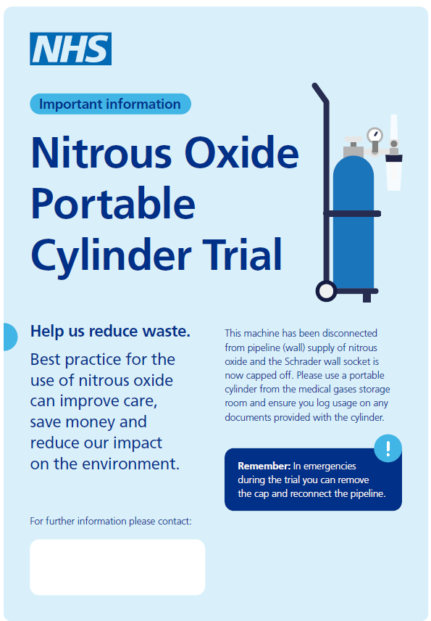
Poster A: nitrous oxide portable
cylinder trial
When to use
To use in case of a temporary pilot or trial of a portable cylinder system. Remember to remove posters from areas once this trial has been completed.
Where to use
In locations where a portable cylinder system trial or pilot is being implemented, i.e., in theatres and/or other clinical areas where nitrous oxide is used.
Download
https://uclpartners.com/wp-content/uploads/A4-poster_NOX-Portable-Cylinder-Trial.pdf

Slide 13
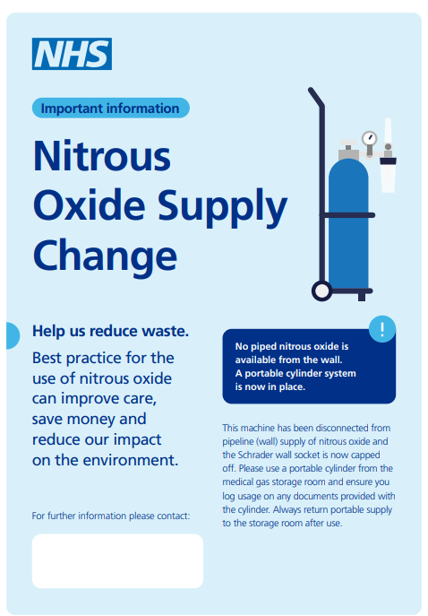
Poster B: nitrous oxide supply change
When to use
To use when a portable cylinder system has permanently replaced a medical gas pipeline system.​
Where to use
Places where a portable cylinder system has been fully implemented, i.e., in theatres and/or other clinical areas where nitrous oxide is used.
Download
https://uclpartners.com/wp-content/uploads/A4-poster_Nitrous-Oxide-Supply-Change.pdf

Slide 14
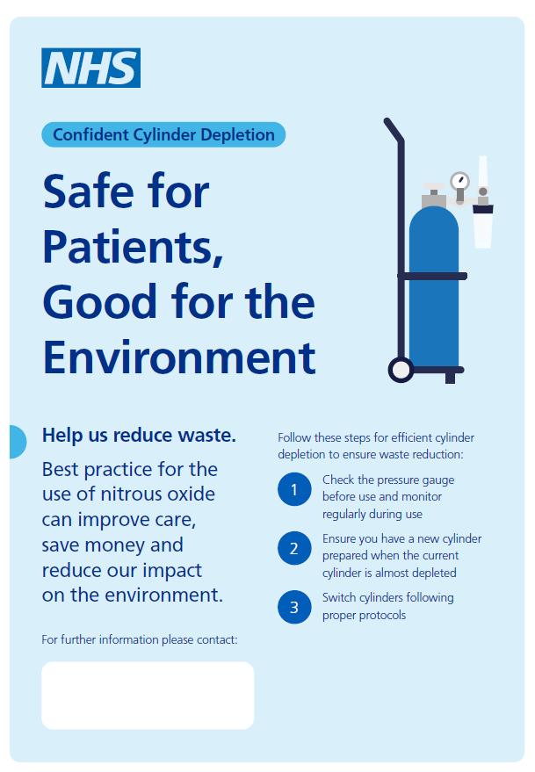
Poster C: safe for patients, good for the environment
When to use
To use when a portable cylinder system is in place to help clinicians using portable cylinders how to safely deplete them.​
Where to use
On the portable cylinder system in theatres and/or other clinical areas where nitrous oxide is used.
Download
https://uclpartners.com/wp-content/uploads/A4-poster_Safe-for-Patients-Good-for-the-Environment.pdf

Slide 15
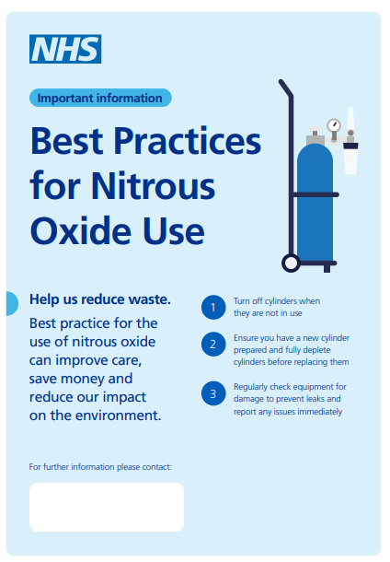
Poster D: best practices for nitrous oxide use
When to use
To use to communicate best practices for using a portable cylinder system efficiently, once it is in place.​
Where to use
On the portable cylinder system in theatres and/or in their storage space.
Download
https://uclpartners.com/wp-content/uploads/A4-posters_Best-Practices-for-Nitrous-Oxide-Use.pdf

Slide 16
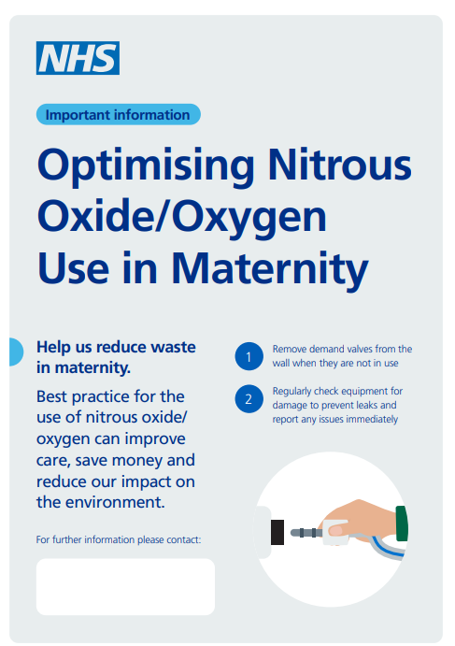
Poster E: optimising nitrous oxide/oxygen
use in Maternity
When to use
To use to communicate best practices for using a portable cylinder system efficiently, specifically for nitrous oxide/oxygen mixture in Maternity and Birthing Units.
Where to use
In the birthing suite and/or the maternity ward.
Download
https://uclpartners.com/wp-content/uploads/A4-posters_Optimising-Nitrous-Oxide-Oxygen-Use-in-Maternity.pdf

Slide 17
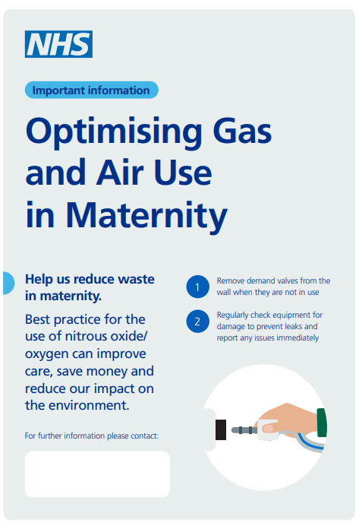
Poster E: optimising gas and air
use in Maternity
When to use
To use to communicate best practices for using a portable cylinder system efficiently in Maternity and Birthing Units. In this version of the poster, nitrous oxide/oxygen is referred to as gas and air.
Where to use
In the birthing suite and/or the maternity ward.
Download
https://uclpartners.com/wp-content/uploads/A4-poster_Optimising-Gas-and-Air-Use-in-Maternity.pdf

Slide 18
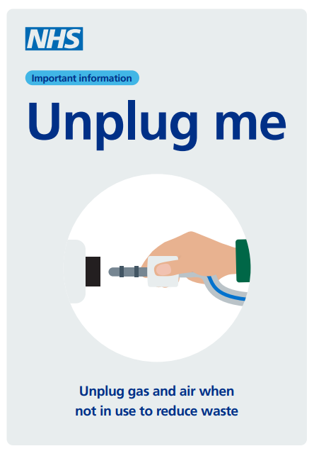
Poster G: unplug me
When to use
To remind clinicians to unplug terminal units and demand valves, where a medical gas pipeline system is retained.​
Where to use
In locations where a medical gas piped supply is retained and demand valves are used.
Download
https://uclpartners.com/wp-content/uploads/A4-poster_Unplug-me.pdf

